Slide 1

How to Prepare a Broad Architectural Barrier Class Action in One Year, Try It in Four Hours, and Win Systemic Injunctive Relief
The Twists and Turns of the
LA Parks Trial
Griffin v. City of Los Angeles, Case No. 24-cv-06312-RGK-MAR (C.D. Cal.)
Guy Wallace, Schneider Wallace Cottrell Kim LLP
Andrew P. Lee, Dardarian Ho Kan & Lee
Scott Gordon, Disability Rights Advocates
Paula Pearlman, Law Office of Paula Pearlman

Slide 2
Nature and Scope of Park Facilities
The City of Los Angeles’s Department of Recreation and Parks operates 559 park facilities, including the following:
  411 playgrounds, including 38 “Universally Accessible Playgrounds”
  319 tennis courts
  123 recreation centers
  130 outdoor fitness areas
  59 swimming pools and aquatic centers
  27 skate parks
  Landmark facilities including Griffith Park and Venice Beach

Slide 3
Pervasive Physical Access Barriers
Parking Barriers
Insufficient number of disabled parking spots
Incorrect striping
Cracked and broken asphalt
Excessive running and cross slopes
Maintenance Barriers
Uneven and rutted decomposed granite
Excessive door pressure
Door opening/closing speeds
Sink drainpipe insulation
Bathroom Barriers
Narrow doorways
Narrow bathroom stalls
Bathroom stalls without grab bars
Entrance and Path of Travel Barriers
Lack of accessible route to park features (e.g., play structures, picnic tables, ball fields)
Cracked and broken walkways
Excessive running and cross slopes
Excessive drop offs
Notes:
Discuss pervasive barriers; barriers start from the beginn
Provide plaintiff and class member stories about impact of barriers
The maintenance division is not trained to and generally does not look at or measure door pressure, sink faucet button pressure, water fountain button pressure, door opening/closing speeds, or sink drain pipe insulation as part of their inspections of park facilities.

Slide 4
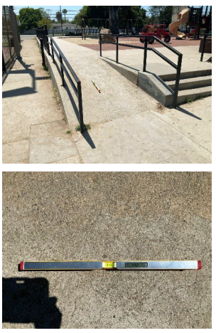
Barrier | Path of Travel
Standard | Ramp runs shall have a running slope not steeper than 1:12 (8.33%). 2010 ADAS 202.4, 305.2; 2010 CBC 1124B.2.1, 1127B.5.3.
As-Built Description | The ramp’s running slope measures up to 14.2%.
Safdie Rule 26 Report, Appx. A, Page A217, Photo 10
Safdie Rule 26 Report, Appx. A, Page A217, Photo 10

Slide 5
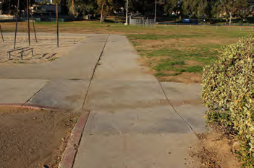
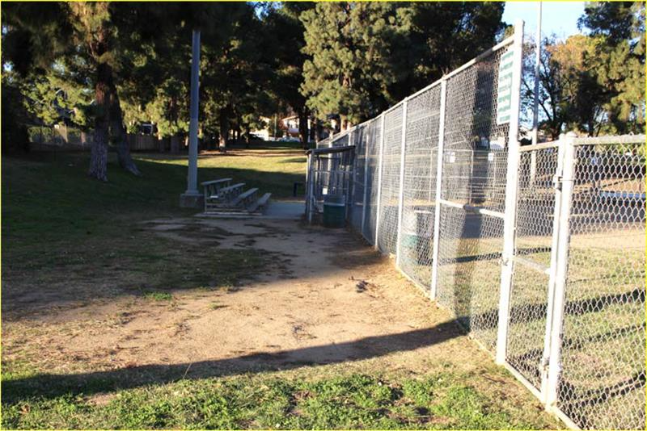
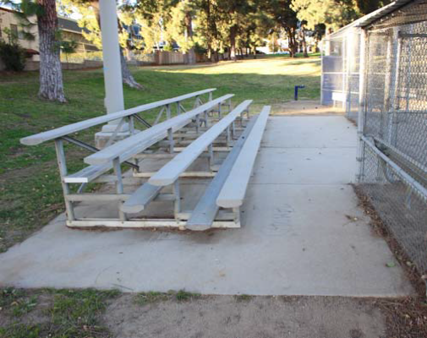
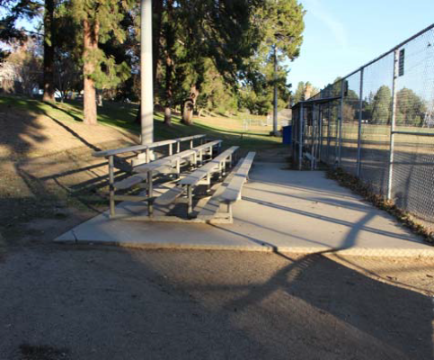
Northridge Recreation Center
Barrier | Path of Travel - Dodger’s Dream Field
Standard | Ground and floor surfaces must be stable, firm and slip resistant. 1991 ADAAG 4.1.2(2) & 4.5.1; 2007-10 CBC 1124B.1.
As-Built Description | The Dodger’s Dream Field can only be accessed by traveling across grass and dirt surfaces that are not firm, stable, and slip-resistant.
Mastin Rule 26 Report, Ex. F, Seq. # 73
Mastin Rule 26 Report, Ex. F, Seq. # 73
Mastin Rule 26 Report, Ex. F, Seq. # 73
Mastin Rule 26 Report, Ex. F, Seq. # 73

Slide 6
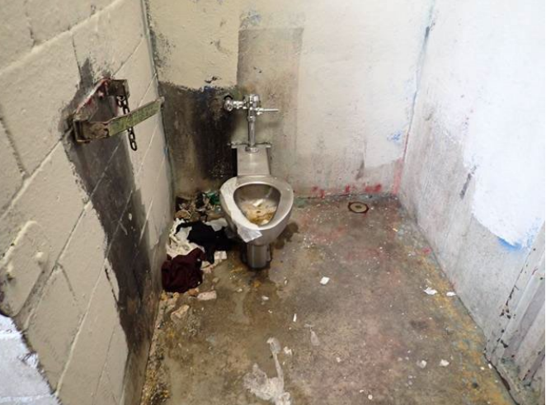
Sycamore Grove Park
Barrier | Accessible Restroom
Standard | Grab bars shall be provided on the side wall closest to the water closet and on the rear wall. 2010 ADAS 604.5, 2016 / 2022 CBC 604.5.
As-Built Description | Grab bars are not provided.
Waters Rule 26 Report, Ex. H, Page 27, Photo 60

Slide 7
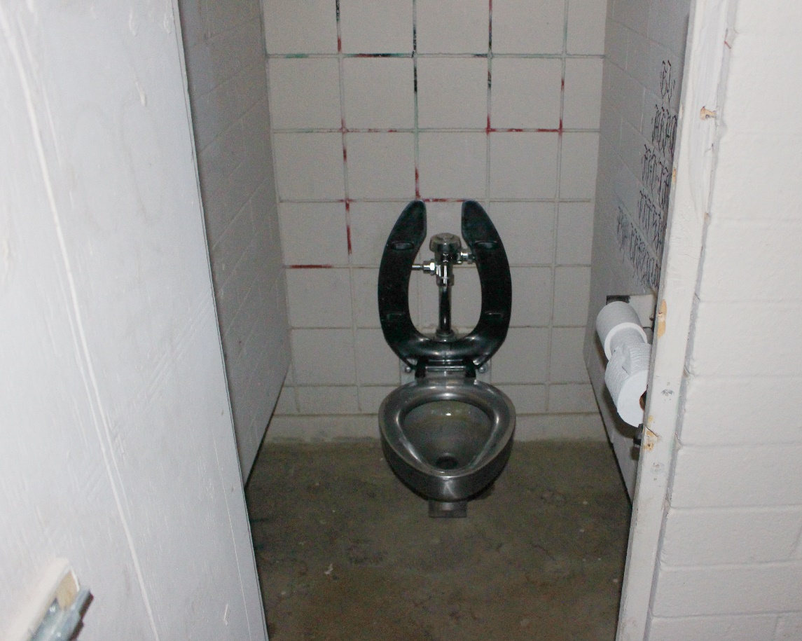
Chatsworth Park North
Barriers | Restroom
Standard | Wheelchair accessible toilet compartment doors shall be 32” wide minimum. 2010 ADAS 604.8.1.2; 2019 CBC 11B-604.8.1.2.
As-Built Description | The toilet compartment entrances are 20-1/2” to 21” wide.
Standard | Wheelchair accessible toilet compartments shall be 60 inches wide minimum. 2010 ADAS 604.8.1.1; 2019 CBC 11B-604.8.1.1.
As-Built Description | All toilet compartments are 36” wide.
Mastin Rule 26 Report, Ex. D, Seq. # 24

Slide 8
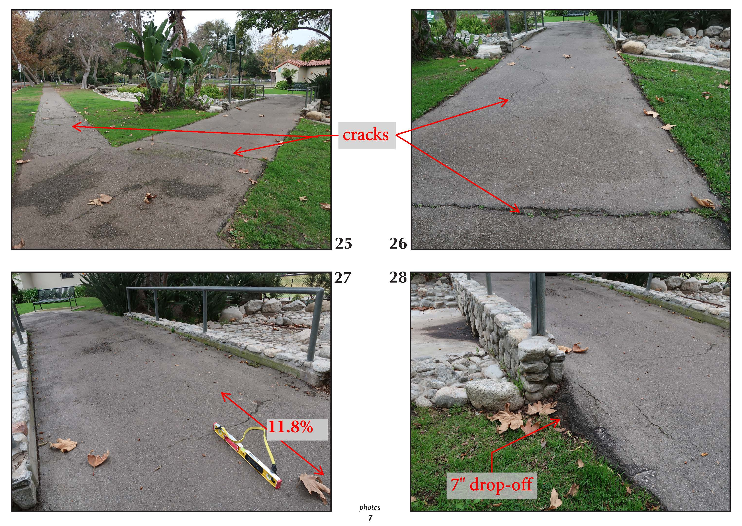
Holmby Park
Photo # | ADAS/ CBC# | Federal Design Standard / CBC Code
25 | 302; 303 | Ground surface not firm and stable - cracking, lifting, weeds
 | 11B-302; 11B-303
26 | 302; 303 | Ground surface not firm and stable - cracking, lifting, weeds
 | 11B-302; 11B-303
27 | 403.3 | Running slope in walking surfaces: 5% maximum
 | 11B-403.3
28
 | 11B-303.5 | Greater than 4 inch vertical change in level requires 6 inch height curb
Kent Rule 26 Report, Ex. F, Page Photos 7, # 25
Kent Rule 26 Report, Ex. F, Page Photos 7, # 26
Kent Rule 26 Report, Ex. F, Page Photos 7, # 27
Kent Rule 26 Report, Ex. F, Page Photos 7, # 28

Slide 9
Legal Claims
Claims
Violation of Title II of the Americans with Disabilities Act (42 U.S.C. § 12131, et seq.)
Violation of Section 504 of the Rehabilitation Act (29 U.S.C. § 794, et seq.)
Violation of California Government Code § 11135
Theory of Liability
Case limited to newly constructed and altered park facilities
No program access claim
Injunctive and Declaratory Relief
Notes:
Discuss pervasive barriers; barriers start from the beginning, i.e. entry into the park
Provide plaintiff and class member stories about impact of barriers

Slide 10
Newly Constructed and Altered Facilities
Government facilities constructed and altered after January 26, 1992 must be “readily accessible to and usable by individuals with disabilities.” 28 C.F.R. § 35.151(a)(1)
The ADAAG, UFAS and the ADAS are the minimum federal standards for accessibility for new or altered facilities. Chapman v. Pier 1 Imports (U.S.) Inc., 631 F.3d 939, 945 (9th Cir. 2011) (en banc).
Dimensional tolerances are permitted. 2010 ADAS § 104.1.1; ADAAG § 3.2.
Cost or undue burden are not defenses to a new construction or alterations claim. See, e.g., Cohen v. City of Culver City, 754 F.3d 690, 696-97 (9th Cir. 2014); Long v. Coast Resorts, Inc., 267 F.3d 918, 923 (9th Cir. 2001); Kinney v. Yerusalim, 9 F.3d 1067, 1071 (3d Cir. 1993); 28 C.F.R. § 35.151.
Notes:
Each facility or part of a facility constructed by, on behalf of, or for the use of a public entity shall be designed and constructed in such a manner that the facility or part of the facility is readily accessible to and usable by individuals with disabilities, if the construction commenced after January 26, 1992.
28 C.F.R. § 35.151(a)(1).
From January 26, 1992 to September 14, 2010, a public entity was permitted to comply with either the 1991 Americans with Disabilities Act Accessibility Guidelines (“ADAAG”) or the Uniform Federal Accessibility Standards (“UFAS”). 28 C.F.R. § 35.151(c)(1).
From September 15, 2010 to March 14, 2012, a public entity was permitted to comply with either ADAAG, UFAS or the 2010 Americans with Disabilities Act Accessibility Standards (“2010 ADAS”). 28 C.F.R. § 35.151(c)(2).
Since March 15, 2012, a public entity was and is required to comply with the 2010 ADAS.
28 C.F.R. § 35.151(c)(3).

Slide 11
Altered Facilities
Areas of alteration that affect the usability of a facility must be readily accessible to and usable by individuals with disabilities to the maximum extent feasible. 28 C.F.R. § 35.151(b)(1).
If alterations are made to a “primary function area,” the path of travel to the altered area, including restrooms, telephones, and drinking fountains serving the altered area, must be readily accessible to and usable by individuals with disabilities. 28 C.F.R. § 35.151(b)(4).
Disproportionality Exception: Path of travel improvements required by an alteration are capped at 20% of the cost of the alteration to the primary function area. 28 C.F.R. § 35.151(b)(4)(iii).
Notes:
Each facility or part of a facility altered by, on behalf of, or for the use of a public entity in a manner that affects or could affect the usability of the facility or part of the facility shall, to the maximum extent feasible, be altered in such manner that the altered portion of the facility is readily accessible to and usable by individuals with disabilities, if the alteration was commenced after January 26, 1992. 28 C.F.R. § 35.151(b)(1).
An alteration that affects or could affect the usability of or access to an area of a facility that contains a primary function shall be made so as to ensure that, to the maximum extent feasible, the path of travel to the altered area and the restrooms, telephones, and drinking fountains serving the altered area are readily accessible to and usable by individuals with disabilities, including individuals who use wheelchairs, unless the cost and scope of such alterations is disproportionate to the cost of the overall alteration. 28 C.F.R. § 35.151(b)(4).
Primary Function: a major activity for which the facility is intended, including the dining area in a cafeteria, meeting rooms in a conference center, and offices / work areas in which the activities of the public entity using the facility area carried out. 28 C.F.R. § 35.151(b)(4)(i).
Path of Travel: a continuous, unobstructed way of pedestrian passage by means of which the altered area may be entered and exited, and which connects the altered area with an exterior approach (including sidewalks, streets and parking areas), an entrance to the facility and other parts of the facility. 28 C.F.R. § 35.151(b)(4)(ii).
Disproportionality: Alterations made to provide an accessible path of travel to the altered area will be deemed disproportionate to the overall alteration when the cost exceeds 20% of the cost of the alteration to the primary function area. 28 C.F.R. § 35.151(b)(4)(iii).

Slide 12
Remediation of Noncomplying New Construction and Alterations
Newly constructed or altered facilities or elements covered by §§ 35.151(a) or (b) that were constructed or altered before March 15, 2012 and that do not comply with the 1991 ADAAG Standards or with UFAS shall, on or after March 15, 2012, be made accessible in accordance with the 2010 ADAS Standards.
28 C.F.R. § 35.151(c)(5)(ii).

Slide 13
Case Origins
Client came to us complaining about inaccessible parks near her home
  Investigated her parks: parking issues; path of travel issues; inaccessible restrooms
  Researched newly constructed or altered parks (created an Excel database)
Site inspections by Disability Access experts (CASp)
  Would later become class certification and trial expert witnesses
Outreach to other plaintiffs and class members, both pre and post filing
  Diversity--Geography, Age, Organizational Plaintiff
  Newsletters, specific outdoor and recreational disability groups, leafleting at parks
Assemble the legal team
  Expertise, resources, local knowledge
  History of collaboration

Slide 14
Case Schedule
Class Action Complaint filed July 26, 2024
Assigned to District Judge R. Gary Klausner
Rocket Docket: Trial occurred 14.5 months after case filing
Five requests to continue case schedule; one granted
The Court’s Standing Order
Notes:
Class Action Complaint filed July 26, 2024 - Anniversary of the ADA
Motion for class certification must be filed no later than 90 days after service of the complaint, unless good cause shown
Briefs cannot exceed 5,600 words (default is 7,000 words per L.R. 11-6.1)
Reply briefs cannot exceed 10 pages
All appearances in person (no remote video appearance or telephone conference calls)

Slide 15
Scheduling Order (as Amended)
Deadline to amend complaint: December 7, 2024
Deadline for joint motion for class certification: January 10, 2025
Deadline for expert reports: June 20, 2025
Non-expert discovery cut-off: August 8, 2025
Pretrial Conference: September 29, 2025
First day of trial (estimated 20 days): October 14, 2025
Notes:
July 26, 2024 – Complaint filed (Anniversary of the ADA)
October 11, 2024 – City’s Answer
October 22, 2024 – Rule 26(f) Conference
October 23, 2024 – Plaintiffs’ first set of written discovery requests
November 12, 2024 – Plaintiffs’ Rule 30(b)(6) notice of deposition
November 18, 2024 – Scheduling Conference with Court
December 6, 2024 – Plaintiffs’ first discovery letter
January 10, 2025 – Joint Motion for Class Certification
January 31, 2025 – Plaintiffs’ first motion to compel
February 13, 2025 – Order Granting Joint Motion for Class Certification
March 26, 2025 – Plaintiffs’ second motion to compel
May through August 2025 – City’s rolling production of documents peaked
June 20, 2025 – Expert reports
August 8, 2025 – Fact discovery cut-off and deadline to file motions
August xx, 2025 – City’s final production of documents
August 29, 2025 – Motions in Limine
September 8, 2025 – Joint Witness List and Exhibit List, Memo of Contentions
September 29, 2025 – Pretrial Conference
October 2, 2025 – Final depositions completed
October 14-16, 2025 – Trial
October 20, 2025 – City’s Motion for Judgment on Partial Findings Pursuant to Fed. R. Civ. P. 52(c)
October 24, 2025 – Plaintiffs’ Opposition to Motion for Judgment on Partial Findings
November 13, 2025 – Order denying City’s Motion for Judgment on Partial Findings
November 20, 2025 – Judgment
January 5, 2026 – Proposed forms of injunction
January 13, 2026 – Order Granting Injunctive Relief
Proposed dates in Joint Rule 26(f) Report (inter alia):
Deadline to amend pleadings: November 7, 2025
Non-expert discovery cut-off: May 8, 2026
Expert reports: July 24, 2026
Expert discovery cut-off: October 9, 2026
Trial: April 6, 2027 (Parties anticipated 20 days of trial)
32.5 months after case filing
See Joint Rule 26(f) Report, ECF No. 39
Requests to Continue Case Schedule
First request: Joint motion to continue trial from July 29, 2025 to December 1, 2025 – filed February 24, 2025, denied in all material respects (ECF Nos. 67, 82)
Second request: Joint stipulation to continue trial from July 29, 2025 to November 4, 2025 – filed May 9, 2025, granted (ECF Nos. 100, 102)
Third request: Joint motion to amend scheduling order – filed August 8, 2025, denied (ECF Nos. 114, 133)
Fourth request: Joint stipulation to continue trial from October 14, 2025 to February 3, 2026 – filed August 14, 2025, denied (ECF Nos. 117, 119)
Fifth request: City’s ex parte application to continue trial – filed September 3, 2025, denied (ECF Nos. 131, 133)

Slide 16
Class Certification
Granted February 13, 2025
Certification pursuant to FRCP 23(b)(2)
Class Definition: “All persons with mobility disabilities, including those who use wheelchairs, scooters, canes or other mobility aids, who use or desire to use the City of Los Angeles’ public parks and park facilities.”
Joint Motion for Class Certification
Evidence: 10 plaintiff/class member declarations; 3 expert declarations; deposition testimony from 1 City employee
Judge’s 90 Day Deadline for Class Certification Motion

Slide 17
Discovery
Plaintiffs served 65 RFPs, 592 requests for admission, 25 interrogatories
60 document productions by City (rolling production)
344,391 pages of documents produced by City
24 depositions taken by Plaintiffs
18 depositions taken by City
2 motions to compel further discovery; both largely granted
Agreements:
  Authenticity
  Disproportionality
  40 hours of Rule 30(b)(6) deposition time
  80 “priority parks” selected by Plaintiffs’ counsel
Notes:
Plaintiffs’ Discovery Requests
Requests for production (4 sets, x requests) – Policies; complaints and grievances; design plans, permits, and other construction documents; maintenance documents; self evaluations; transition plan; budgets
Requests for admission (4 sets, y requests) – Construction and alteration history; sources of funding
Interrogatories (3 sets, z requests) – Descriptions of policies; witness information; accessibility surveys; identifying new and altered park facilities and scope of alterations; actions taken by City to maintain accessibility of park features
Rule 30(b)(6) notice of deposition – q topics
Plaintiffs took 24 depositions
Multiple Rule 30(b)(6) deposition sessions for City officials from different departments (Rec and Park; Bureau of Eng.; Building and Safety; Disability)
Individual capacity depositions of City officials/employees
Access experts retained by City
City took 18 depositions
11 depositions of Plaintiffs and class members
7 expert depositions
Depositions concluded on October 2, 2025 (12 days before trial)
Parties completed 41 deposition sessions from March x to October 2
Discovery Disputes
City’s overbreadth objections
Stood on objections to Plaintiffs’ first set of interrogatories
Bitterly protested burden and complexity of requested document production, particularly with 500+ parks
Objected to Rule 30(b)(6) deposition notice
Plaintiffs’ first discovery letters in December 2024
First motion to compel – filed January 31, 2025; sought responses to Plaintiffs’ interrogatories; granted in part on March 5, 2025 (ECF Nos. 57, 72)
Second motion to compel – filed March 26, 2025; sought responses to Plaintiffs’ requests for production; granted in part on May 9, 2025 (ECF Nos. 83, 101)
Document Production
Rolling production:
344,391 thousand pages of documents
60 total productions
Peaked in approx. May through August 2025 (following motions to compel)
Final production was Sept. 30, 2025 (after discovery cut-off)
Relativity (for document review and coding)
Types of documents: construction and alteration documents (design plans, permits, emails), BlueDag data, complaints, policies, budgets
Post cut-off productions
52 - 8/22/2025, Friday night, contained some bad files and missing files.
53 - 8/27/2025.
54 - 9/2/2025, one of the file folders was empty and there was a bad DAT file.
55 - 9/9/2025, contained some unviewable files.
56 - 9/17/2025.
57 - 9/19/2025, Friday night.
58 - 9/19/2025, Friday night.
59 - 9/26/2025, Friday night, D forgot to send password to access files.
60 - 9/30/2025
After the discovery and motion cut-off on August 8, 2025, the City produced nine sets of documents totaling 33,647 pages – nearly 10% of the total number of pages the City produced to Plaintiffs.

Slide 18
Expert Work
Plaintiffs hired seven disability access experts
  6 California Certified Access Specialists (CASp)
  5 licensed architects
  One expert on accessibility standards
76 parks inspected by Plaintiffs’ experts
6,221 access barriers identified by Plaintiffs’ experts
  Experts provided matrixes
  Combined Excel sheet prepared by Plaintiffs’ counsel
Rule 26 expert reports served June 20, 2025
All six CASps testified at trial
Notes:
What is a CASp?
A Certified Access Specialist (CASp) is a professional who has passed an examination and has been certified by the State of California to have specialized knowledge of the applicability of state and federal construction-related accessibility standards. A CASp will know which standards apply to your property based on the age of your facility and its history of improvements. While a licensed design professional, such as an architect or engineer, can provide you an access compliance evaluation of your facility, only a CASp can provide services that offer you “qualified defendant” status in a construction-related accessibility lawsuit.
Source: https://www.dgs.ca.gov/DSA/Resources/CASp-Property-Inspection
Plaintiffs retained six CASps as experts
Three CASps retained before class certification
Inspected 10 parks in December 2025
Provided declarations and reports for class certification motion
Three additional CASps retained after class certification
Inspected 66 parks from March to June 2025
Two CASps employed a team of inspectors (each assessed 20+ parks)
Onsite inspections at 76 parks in total
Five of six CASps were also licensed architects
Additional architectural expert re purposes of accessibility standards
Expert Reports
Served June 20, 2025
Barriers identified under both federal standard (ADAS or ADAAG) and applicable version of California Building Code
Narrative sections describing the park facilities inspected, access barriers identified, and construction and alteration histories
Matrixes provided details for each barrier (measurements, applicable access standards, photos)
Opinions regarding City’s design plans
Certain experts reviewed City’s policies
Overall conclusions

Slide 19
Establishing Construction Histories
Plaintiffs’ experts used the following documents to assess histories of construction and alteration at park facilities:
Board reports to the Board of Recreation and Parks Commissioners
Google Earth and Google Maps historical imagery
Design plans
Building permits
Responses to requests for admission

Slide 20
Motion for Leave to Amend Complaint
Plaintiffs filed a motion for leave to amend their complaint on August 8, 2025 (ECF Nos. 113, 116)
Sought to amend complaint to allege additional, specific access barriers at City parks
  All barriers identified by the named Plaintiffs and class members in class certification declarations and in their July 2025 depositions
  All barriers detailed by Plaintiffs’ experts in their expert reports
  All barriers identified by inspectors hired by the City to conduct onsite surveys as part of its self-evaluation process (documented in a proprietary BlueDag database)
Court denied the motion

Slide 21
Trial Surprises
Plaintiffs prepared for a 20-day trial
  Trial time reduced to 4 hours per side two weeks before trial
Plaintiffs prepared to present evidence from approximately 75 park facilities
  Plaintiffs were limited to evidence from the 9 parks identified in the complaint two weeks before trial
7 plaintiffs’ attorneys prepared direct and cross examinations
  Questioning of witnesses was limited to 2 attorneys per side on the morning of the first day of trial
Weather Conditions
  Atmospheric river on first day of trial

Slide 22
Trial
Plaintiffs’ Case
18 total witnesses
10 live witnesses (4 Named Plaintiffs; 6 Disability Access Experts)
      8 City employee witnesses testified by deposition designation using excerpts and transcripts from videotaped depositions (highlight reel)
      4 hours of direct examination
      Opening and closing statements
      City’s Case
      8 Live Witnesses (City Employees)
      No experts
      20 minutes of cross examination
      Opening and closing statements

Slide 23
Injunctive Relief Order
Judgment for Plaintiffs November 20, 2025
Injunctive Relief Order issued January 12, 2026
Barrier remediation of specific barriers presented at trial within 180 days of Order limited to 8 park and recreation facilities
Adopt and implement a formal written policy requiring all violations of Title 24 of the Cal. Building Code to be corrected within 90 days of discovery
Prominently post at public entrances at all parks signage on how to file an accessibility complaint within 180 days of order
Court retains jurisdiction to enforce the Order or resolve disputes arising from Order

Slide 24
Take Aways
A limited evidentiary showing can support systemic injunctive relief.
The Oliver pleading requirement must be addressed through appropriate case management.
Trial planning: efficiency and flexibility are critical.
Don’t underestimate the importance of trial logistics.

Slide 25
Systemic Injunctive Relief
“System-wide relief is required if the injury is the result of violations of a statute or the constitution that are attributable to policies or practices pervading the whole system (even though injuring a relatively small number of plaintiffs), or if the unlawful policies or practices affect such a broad range of plaintiffs that an overhaul of the system is the only feasible manner in which to address the class’s injury.” Armstrong v. Davis, 275 F.3d 849, 870 (9th Cir. 2001).
How much evidence is necessary to prove a systemic violation?

Slide 26
Trial Planning
Efficiency: How did we maximize our trial time?
  Friendly witnesses (plaintiffs and experts) testified live
  Adverse witnesses were presented through deposition designation (aka the “highlight reel”)
  Scripted and rehearsed direct examinations allowed us to stay within time limits with curated trial exemplars of park facility barriers
  Minimal time spent on expert qualifications
  No duplicative evidence/arguments: “… if I have read it before, it's not going to mean much when you say a second or third time, unless you really think, maybe I am stupid. We will find that out.”
  Managed witness availability so there was no wasted time
Notes:
Trial time is precious; use every second
“Time is your currency”
Talk about the process of making the highlight reel
Doar and trial exhibits
Tech assistance in court

Slide 27
The Oliver Pleading Requirement
Oliver v. Ralphs Grocery Co., 654 F.3d 903, 908 (9th Cir. 2011)
Individual plaintiff alleged physical access claims against public accommodation (ADA Title III)
District court refused to consider barriers identified in plaintiff’s expert report but not alleged in complaint; Ninth Circuit affirmed
Held: ADA plaintiff must “identify the specific barriers for which the plaintiff seeks injunctive relief” in their complaint to obtain remediation for those barriers
  Plaintiff did not give defendants fair notice that the barriers identified for the first time in the expert report were grounds for his claim of discrimination – Fed. R. Civ. P. 8
  “a disclosure made during discovery, including in an expert report, would rarely be an adequate substitute”
Judge Klausner applied Oliver to this case

Slide 28
Practical/Logistical Issues
Courthouse Accessibility
Worked with the district court, clerk and GSA to ensure courthouse and courtroom accessibility
Accessible entrance was opened during limited hours
Seating inside the courtroom for plaintiffs and class members and attorneys
Witnesses – location and how plaintiffs testify, screens to see exhibits, microphones, and removal of existing seating to accommodate wheelchairs
Coordinating with Witnesses
Scheduling: trial preparation and testimony
Plaintiffs use of social media and other technologies e.g. no posting on Instagram; texting preferred
Trial Consultant
Courtroom technology
Demonstratives
Other Logistical Considerations
Hotel near courthouse with conference room, breakout rooms, and full-size printer
Workspace / meeting area at courthouse
Team meals
Supplies (dollies, binders, exhibit tabs, etc.)
Transportation – getting people and materials to the courthouse

Slide 29
Questions?
Contact Info
Guy Wallace
Schneider Wallace Cottrell Kim LLP
gwallace@schneiderwallace.com
(415) 421-7100
Scott Gordon
Schneider Wallace Cottrell Kim LLP
sgordon@schneiderwallace.com
(415) 421-7100
Andrew Lee
Dardarian Ho Kan & Lee
alee@dhkl.law
(510) 763-9800
Paula Pearlman
Law Office of Paula Pearlman
pauladpearlman@gmail.com
(213) 760-1340

