Slide 1

Using Disability Rights to Challenge Anti-DEI Laws
March 27, 2026
Presented by Zoe Brennan-Krohn, Jennesa Calvo-Friedman, and Alexis Alvarez
Notes:
Settling in/intros: 10:30-10:35

Slide 2
Session Outline
Introduction: DEI(A) and Disability
Background: Federal and State Anti-DEI initiatives
Case studies:
  NEA-NH v. New Hampshire
  Head Start
Reflections and Discussion
Notes:
10:35-10:45
Zoe

Slide 3
Introduction: DEI(A) and Disability
"Diversity, Equity, Inclusion, and Accessibility" (DEIA) is in the crosshairs of the federal government, adopted by other entities including states
What does DEIA mean?
  No single definition
  Often used as a general shorthand for a huge range of concepts including:
    Quotas and affirmative action in hiring or admission
    Acknowledgement of the history of racism in the United States, anti-bias training
At its most coherent (perhaps): anything other than formal equality: treatment of any person or population differently than others in order to level the playing field or acknowledgment that the playing field is not level
Notes:
10:35-10:45
Zoe

Slide 4
Introduction: DEI(A) and Disability
Governments are not typically proceeding with coherence:
  E.g., Head Start programs forbidden from using the following words:
    Gulf of Mexico
    Political
    Trauma
    Pollution
    Victim
    Native American
    Equality
Notes:
10:35-10:45
Zoe

Slide 5
Introduction: DEI(A) and Disability
Where does disability fit in?
  Very unclear!
    Rhetorically
    Practically
How do you prohibit conduct or training in furtherance of “accessibility” without running afoul of federal disability rights laws?
  You often can’t!
Notes:
10:35-10:45
Zoe

Slide 6
Introduction: DEI(A) and Disability
Why bring disability into the morass of DEIA?
  Disabled communities are being targeted
    Disability is not an inadvertently included population, and
    Many impacted disabled people are marginalized across other identities, including those most directly in the crosshairs of DEI bans (racial, linguistic, gender, sexual orientation)
Notes:
10:35-10:45
Zoe

Slide 7
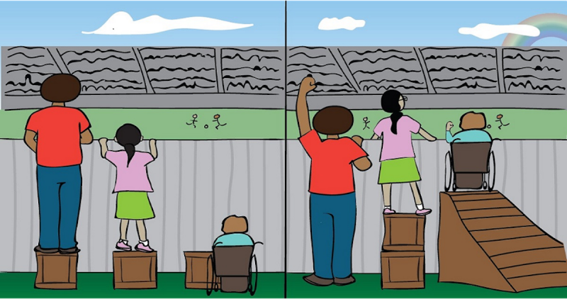
Introduction: DEI(A) and Disability
Why bring disability into the morass of DEIA?
  Disability rights laws have particular power in this context
    ADA, 504, and IDEA are all squarely about equity, not equality
    Often require different treatment to level the playing field, exactly what DEIA bans try to prohibit
Equality vs. Equity
Notes:
10:35-10:45
Zoe

Slide 8
Background: Federal and State Anti-DEI initiatives
Project 2025
Abolishing DEI offices and personnel;
Ending the government’s participation in DEI initiatives
Amending laws to align with a conservative vision of nondiscrimination
Taking enforcement action against organizations that engage in DEI

Slide 9
Background: Federal and State Anti-DEI initiatives
E.O. 14173
Ending Illegal Discrimination and Restoring Merit-Based Opportunity, January 21, 2025
Agencies required to “include in every contract or grant award” a certification that the recipient “does not operate any programs promoting DEI that violate any applicable Federal antidiscrimination laws,”
Attorney General required to take “appropriate measures to encourage the private sector to end illegal discrimination and preferences, including DEI,” to “deter” such “programs or principles,” and to “identify . . . potential civil compliance investigations” to accomplish such “deter[rence].”

Slide 10
NEA-NH v. NH Dep’t of Education

Slide 11
NEA-NH v. NH Dep’t of Education
  New Hampshire’s HB2 (2025)
  “No state funds shall be expended to public schools for DEI-related activities, including but not limited to implicit bias training, DEI assessments, critical race theory, or race-based hiring, promotion, or contracting preferences.”
  DEI defined as “any program, policy, training, or initiative that classifies individuals based on characteristics identified in RSA 354-A:1, (age, sex, gender identity, race, creed, color, marital status, familial status, physical or mental disability or national origin) to achieve demographic outcomes, rather than treating individuals equally under the law.”

Slide 12
NEA-NH v. NH Dep’t of Education
  New Hampshire’s HB2 (2025)
  “No public school shall implement, promote, or otherwise engage in any DEI-related initiatives, programs, training, or policies.”
  “No public school shall enter into, renew, or amend any contract that includes DEI-related provisions, including requirements for contractors to implement DEI programs, conduct DEI training, or comply with DEI-related reporting obligations.”

Slide 13
NEA-NH v. NH Dep’t of Education
  New Hampshire’s HB2 (2025)
  Certification from NHDOE: “Should a public school fail to abide by any section of the DEI provisions to HB 2, either knowingly or unknowingly, the Commissioner of the Department of Education shall immediately halt all sources of public funding to that public school, until such time as the school comes into compliance with all sections of this subdivision”

Slide 14
NEA-NH v. NH Dep’t of Education
  ACLU, ACLU-NH, GLAD Law, NEA, NEA-NH filed lawsuit challenging HB2 on behalf of:
    School districts in NH
    NEA-NH
    Higher Ed Professor
    DEI Training Professional

Slide 15
NEA-NH v. NH Dep’t of Education
  Preemption Claim – HB2 conflicts with the ADA, RA, and IDEA
    Where a federal law conflicts with a state law, the conflicting provisions of state law cannot stand

Slide 16
NEA-NH v. NH Dep’t of Education
  ADA & RA’s requirements in schools:
    “reasonable modifications in policies, practices, or procedures when the modifications are necessary to avoid discrimination on the basis of disability.” 28 C.F.R. § 35.130(b)(7)(i);
    Auxiliary aids and services for effective communication, 28 C.F.R. § 35.160(b)(1), (2)

Slide 17
NEA-NH v. NH Dep’t of Education
  ADA & RA’s requirements in schools:
    must consider systemic impact of policies & procedures on disabled people:
      Prohibited from doing things “[t]hat have the effect of subjecting qualified individuals with disabilities to discrimination on the basis of disability; [t]hat have the purpose or effect of defeating or substantially impairing accomplishment of the objectives of the public entity’s program with respect to individuals with disabilities; [or t]hat screen out or tend to screen out an individual with a disability or any class of individuals with disabilities from fully and equally enjoying any service, program, or activity.” 28 C.F.R. § 35.130(b)(3)(i)–(ii), (4)(i)–(ii).
    Requires placement in most integrated environment. 34 CFR § 104.35

Slide 18
NEA-NH v. NH Dep’t of Education
  IDEA’s requirements in schools:
    identify all children with suspected disabilities, 20 U.S.C. § 1412(a)(3); 34 C.F.R. § 300.111(c)
    evaluate their present level of academic and functional achievement, 20 U.S.C. §1414(c)(1)(B)(ii); 34 C.F.R. § 300.320(a)(1)
    develop an Individualized Education Program (“IEP”) that contains a “statement of measurable [academic and functional] annual goals” and “how the child’s progress toward meeting the annual goals . . . will be measured,” 20 U.S.C. § 1414(d)(1)(A)(i)(I)-(II); 34 C.F.R. § 300.320(a)(2)(i)

Slide 19
NEA-NH v. NH Dep’t of Education
  IDEA’s requirements in schools:
    provide individualized special education services, instruction, and support to help students with disabilities meet their individualized goals in the “least restrictive environment.” 20 U.S.C. § 1412(a)(1)(A); Endrew F v. Douglas Cnty., 580 U.S. 386, 401 (2017); 20 U.S.C. § 1412(a)(5)(A)
    report data regarding the provision of a FAPE and Child Find, and to create a plan that sets “measurable and rigorous targets” with respect to the provision of a FAPE and Child Find. 20 U.S.C. §§ 1412(a)(16)(D), 1413(a)(7), 1416(a)(3)(A)–(B), (b)(1)–(2), 1418(a)

Slide 20
NEA-NH v. NH Dep’t of Education
  Preemption argument:
    By definition, reasonable accommodations under the ADA and Section 504, and special education services under IDEA, do not “treat individuals equally”—rather, they provide services, supports, or accommodations that are not provided to others.
    Thus run afoul of HB2’s prohibition on classifying individuals “to achieve demographic outcomes, rather than treating individuals equally under the law”
    So HB2 is preempted

Slide 21
NEA-NH v. NH Dep’t of Education
  NH’s argument:
    HB2 prohibits classifying individuals “to achieve demographic outcomes, rather than treating individuals equally under the law”
      This phrase carves out compliance with disability rights laws, because those laws are intended to treat people equally

Slide 22
NEA-NH v. NH Dep’t of Education
  Plaintiffs’ response:
  “[T]his argument erroneously conflates equal opportunities with equal treatment, a conflation that finds no purchase in federal disability rights laws.”
  “the ADA, Section 504, and the IDEA recognize that different treatment may be required to allow people with disabilities to achieve equal opportunities.”
  “It is this foundational concept of disability rights laws, explicit in the statutes themselves and confirmed by the Supreme Court, that runs directly contrary to HB2.”

Slide 23
NEA-NH v. NH Dep’t of Education
    Plaintiffs’ Response
    “Defendants ignore this key distinction between equal treatment and equal outcomes and fail to explain how the structure of disability rights laws could be harmonized with the text of HB2.”
    “Defendants further fail to explain why, even under their generous reading of HB2’s “equal treatment” clause, HB2 does not frustrate a core objective of federal disability rights law—improving demographic outcomes.”

Slide 24
NEA-NH v. NH Dep’t of Education
    Preliminary Injunction Granted
    “Simply stated, the ADA and Section 504 require covered entities to treat qualified individuals with disabilities differently than how they treat individuals without disabilities when such differing treatment is reasonable and necessary to permit individuals with disabilities to access the covered entity’s programs or services. This necessarily entails that the covered entity “classif[y] individuals” based on one of the characteristics forbidden in the anti-DEI laws—disability—“for the purpose of achieving demographic outcomes,” i.e., providing disabled individuals with an opportunity to access the benefits of a covered entity’s programs or services.”
    “The ADA and Section 504 require schools to treat disabled students differently in order to achieve disability-related outcomes, yet the anti-DEI laws forbid this same conduct.”

Slide 25
NEA-NH v. NH Dep’t of Education
    Scope of relief
      NH argued that relief should be limited to narrowly enjoining enforcement of HB2 as to programs addressing disability rights rather than enjoining the entire statute
      Ps’ additional claims: Fifth Amendment void for vagueness, First Amendment, state law claims

Slide 26
NEA-NH v. NH Dep’t of Education
    Scope of relief
      PI limited relief to the parties & anyone working or contracting with the parties (CASA v. Trump – limits use of “universal injunctions”)
        Needed to account for students with disabilities who were sent to other school districts

Slide 27
NEA-NH v. NH Dep’t of Education
    Case status
    Briefing summary judgment
    NH legislature doubling down
      Bill amending HB2 gives all citizens the ability to sue to enforce the law
      Exempts ADA compliance from the law, but not the RA and IDEA!

Slide 28

Head Start Litigation
Washington State Association of Head Start and Early Childhood Education and Assistance Program v. Kennedy

Slide 29
Head Start Background
Nationwide program created by Congress to deliver comprehensive early learning, health, nutrition, and family support services to children who are living in poverty.
Started In 1965—as an outgrowth of the Civil Rights Movement—served 40 million children, currently approximately 800,000 a year.
Operates as a partnership between the federal government and local non-profit organizations. Administered by Office of Head Start within HHS
Congress directs Head Start providers to meet the needs of these diverse families, including through inclusion of children with disabilities.

Slide 30
Statutory & Regulatory Requirements of Head Start
Ensure that at least 10% of their total enrollment is filled by children with disabilities. 42 U.S.C. § 9835(d)(1), 45 C.F.R. § 1302.14(b)
Ensure that a child with a “disability or chronic health condition or its severity” has equal access to program’s services as other children. 45 C.F.R. § 1302.14(a)(5)
Create inclusive and accessible classrooms for children with disabilities. 45 C.F.R. §§ 1302.61, 1303.75(a)
Use a multi-disciplinary approach that promotes “mental health, social and emotional well-being,” provide ongoing mental health consultation, and build community partnerships to facilitate additional mental health resources. 45 C.F.R. §§ 1302.45(a)–(b), 1302.46
Provide specific training for staff who work with children with disabilities. 45 C.F.R. § 1302.92
Notes:
Head Start statute has requirements that impose similar obligations as the IDEA (IDEA applies to certain federally funded early intervention programs but not Head Start as a whole)

Slide 31
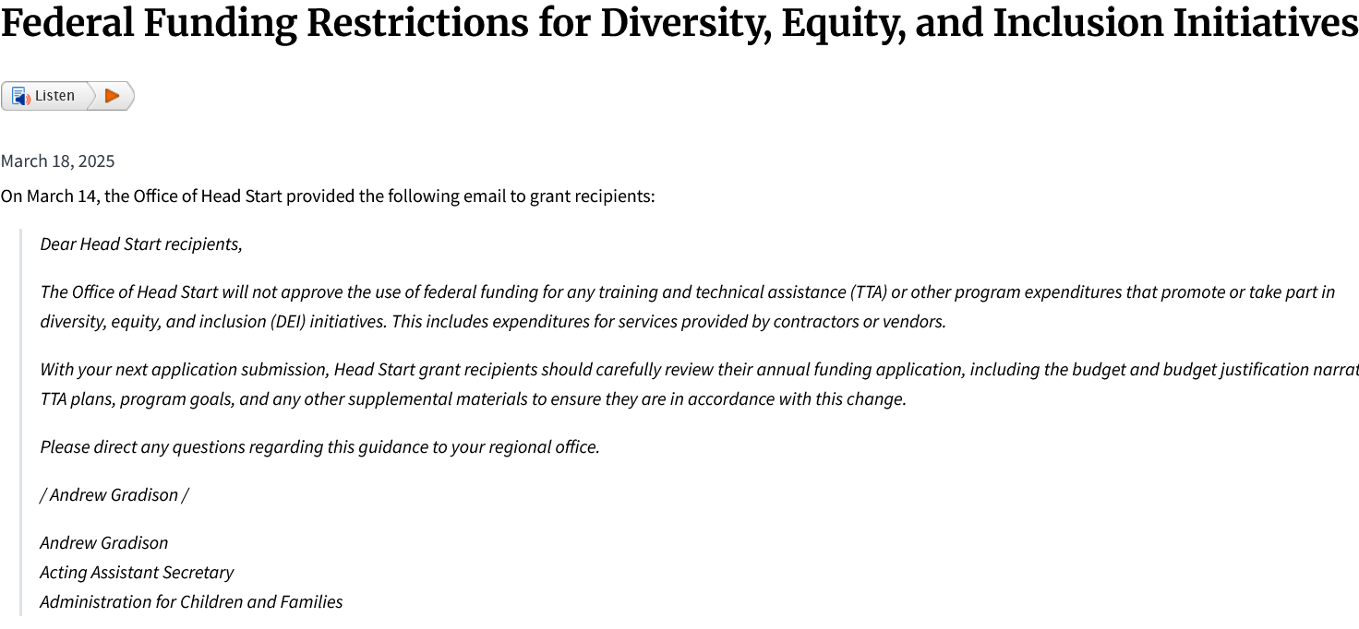
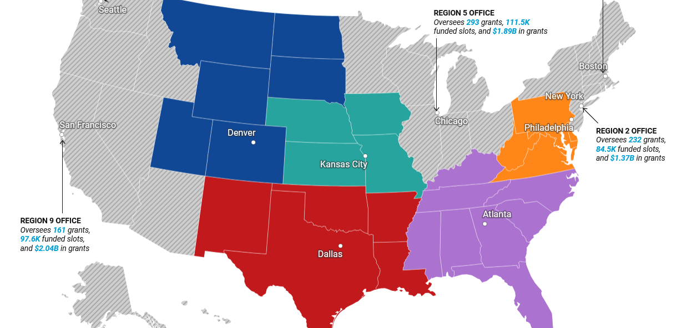
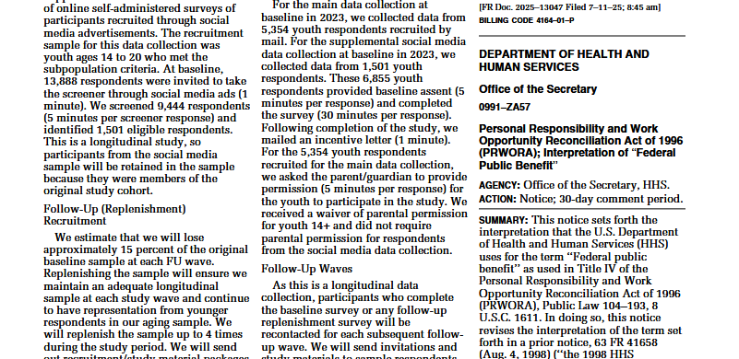
DEIA Ban
Mass Cuts at OHS and Closure of Regional Offices
Immigrant Exclusion Directive
Notes:
Head Start is under threat.
At its core an equity program
Project 2025 called for its elimination, leaked version of budget attempted to eliminate it.
When that was not successful, gutting it from the inside.
Lawsuit addresses three of the attacks, one of which is the DEIA Ban, which is the one I will focus on. But the other two are:
Mass Cuts: Elimination of 60% of the staff and five of the regional offices of the federal staff that pursuant to statute administer the Head Start program. This has resulted in delayed grants, staffing challenging, and destabilization
Immigrant Exclusion Directive – which was a notice issued last July which would require Head Start agencies to screen for immigration status for the first time in 60 year history.
Plaintiffs are 4 state head start associations and two organizations of parents with children in Head Start

Slide 32
HHS Implementation of anti-DEIA EOs
(1) March 14, 2025 Letter to Head Start agencies:
  “the Office of Head Start will not approve the use of federal funding for any….program expenditures that promote or take part in diversity, equity, and inclusion (DEI) initiatives”
(2) April 16, 2025 DEIA Certification:
  HHS updated Grants Policy Statement to require certification under penalty of False Claims Act that agency “do[es] not, and will not during the term of this financial assistance award, operate any programs that advance or promote DEI, DEIA, or discriminatory equity ideology in violation of Federal anti-discrimination laws”
(3) Enforcement through grant administration
  Return of non-competitive renewal grants for having “DEIA” words
Notes:
HHS’s implementation of the anti-DEIA Executive Orders.
March 14, 2025 Letter – note not limited to “illegal” DEI
DEIA Certification – note not limited to federal funds but does have the “illegal” caveat
In litigation government says the ban means that compliance with anti-discrimination laws

Slide 33
What does it mean to ban promoting “accessibility” and “inclusion” for Head Start ?

Slide 34
Government documents - Example
HHS definition of “Inclusion in early childhood programs,” as “including children with disabilities in early childhood programs together with their peers without disabilities.”
HHS & U.S. DOE, Policy Statement on Inclusion of Children with Disabilities in Early Childhood Programs at 3 (Sept. 14, 2015); HHS & DOE, Policy Statement on Inclusion of Children with Disabilities in Early Childhood Programs at 6 (updated 2023) (similar).
Notes:
Term of art in education context
For over a decade, HHS has defined “inclusion in early childhood education programs” – which incudes Head Start – as “including…

Slide 35
Experts in the Field – Example
Declaration of Katherine Neas
  Current: Chief Executive Officer of The Arc of the United States
  Prior: Deputy Assistant Secretary and Acting Assistant Secretary for the Office of Special Education and Rehabilitative Services at the U.S. Department of Education (OSERS).
Explains:
  “Inclusive practices are when children with disabilities learn alongside children without disabilities. Inclusion is beneficial for all children because it gives them the opportunity to learn that all children have unique strengths and unique differences.”
  Head Start is a program established by Congress to fulfill the federal government’s responsibility to ensure that young children with disabilities and their families are included in high-quality early childhood programs
  Head Start is an appropriate placement for many young children to receive special education services and supports.
  “There are too few inclusive options available to preschoolers with disabilities and Head Start affords them a high quality early education experience”

Slide 36
      Head Start Agencies – Examples
Professional development and training for providing inclusive learning for children with disabilities
Inclusive classrooms
Individualized services
A strength-based approach to identify and support developmental needs early
Working with specialists to develop and implement IEPs or Individualized Family Service Plans (“IFSPs”).
Placing trained specialists in classrooms to assist both children and other staff with supporting children with disabilities.
Purchasing materials (e.g., special sensory toys)
Physically modification facilities for accessibility and safety (e.g., for autistic children)

Slide 37
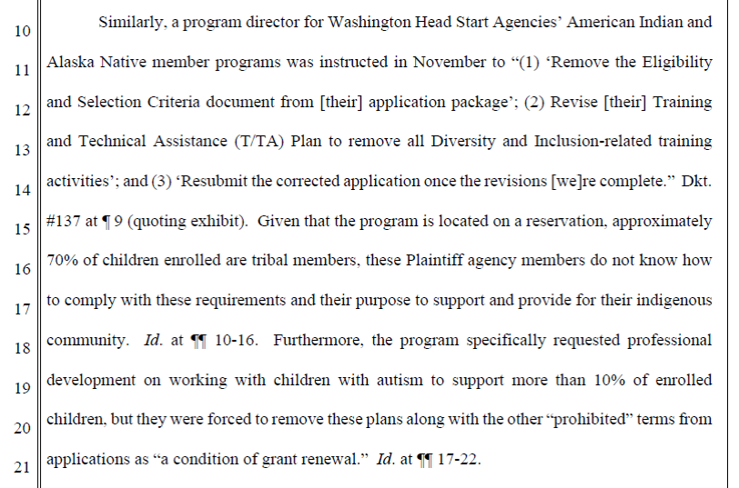
Office of Head Start (HHS) Staff – Examples
Required to remove: e.g., anti-bias training, program goal aimed at addressing marginalization of underrepresented groups in the workplace, “non-English speaker” as a selection criterion, disband an internal DEIA committee, terminate its cultural awareness training, planned training on the ADA, remove the word “pregnant” from programming mater
Notes:
Examples of how disability gets included in ban on DEIA

Slide 38
Office of Head Start Staff – Examples Continued
Rejected a grant application from a Washington HSA member because “terms within [the] application...may be construed to reference...DEI terms.”
The offending terms are:
  (1) “Respect and acceptance for all: recognizing, valuing, encouraging and supporting community and individual differences and perspectives,” and
  (2) “Ensure the unique qualities of each family are affirmed as strengths and staff experience a program where everyone belongs.”

Slide 39
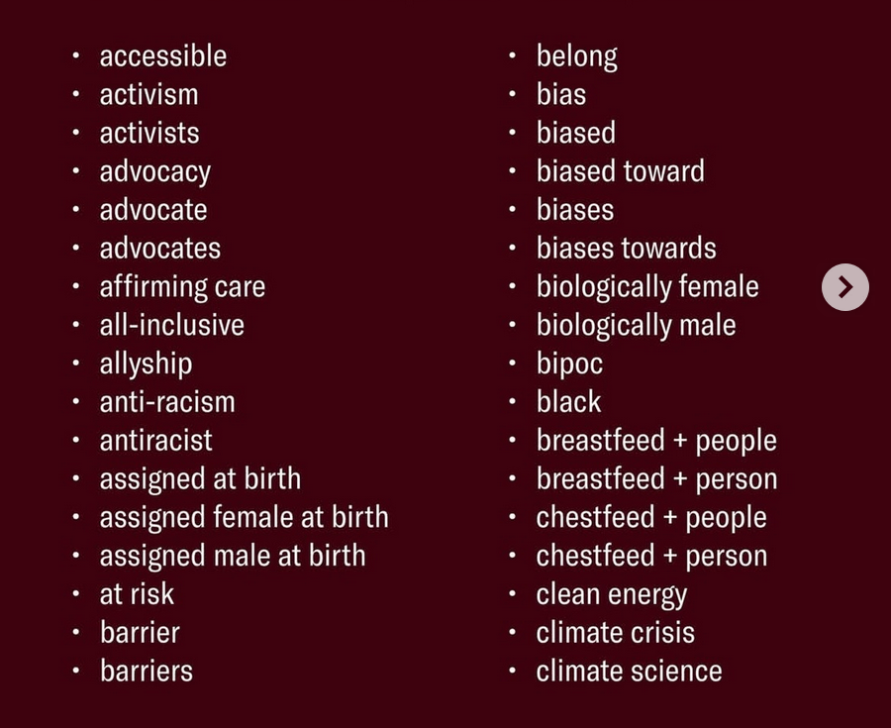
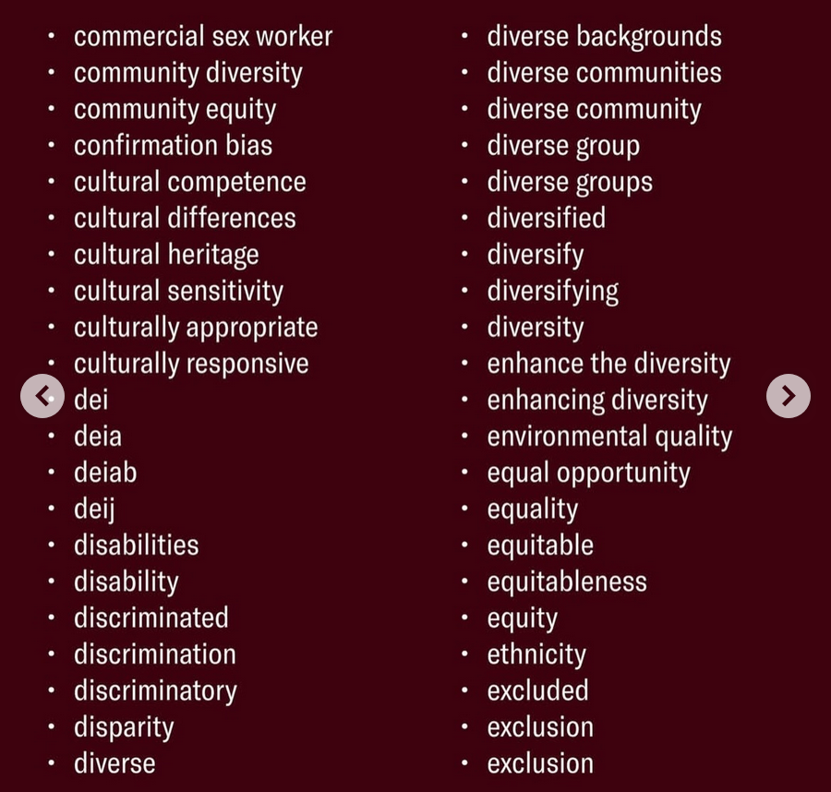
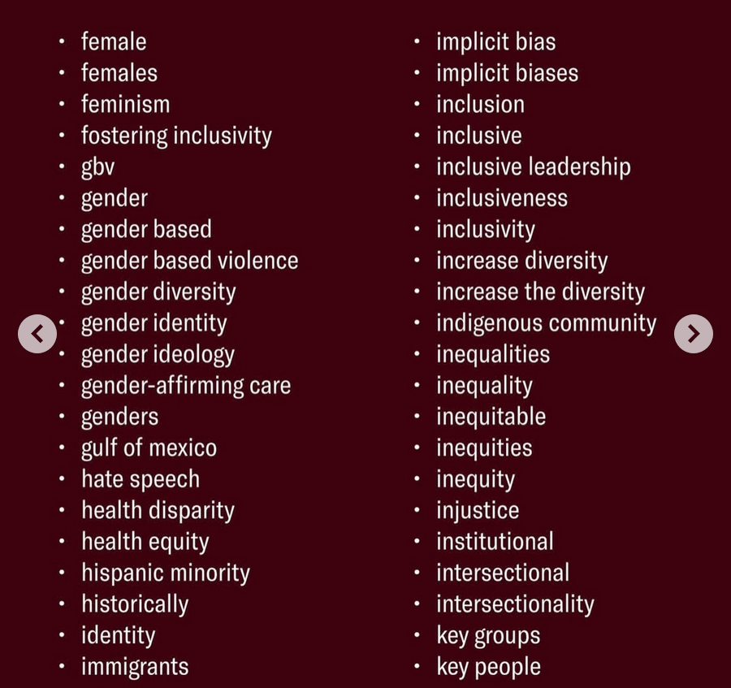
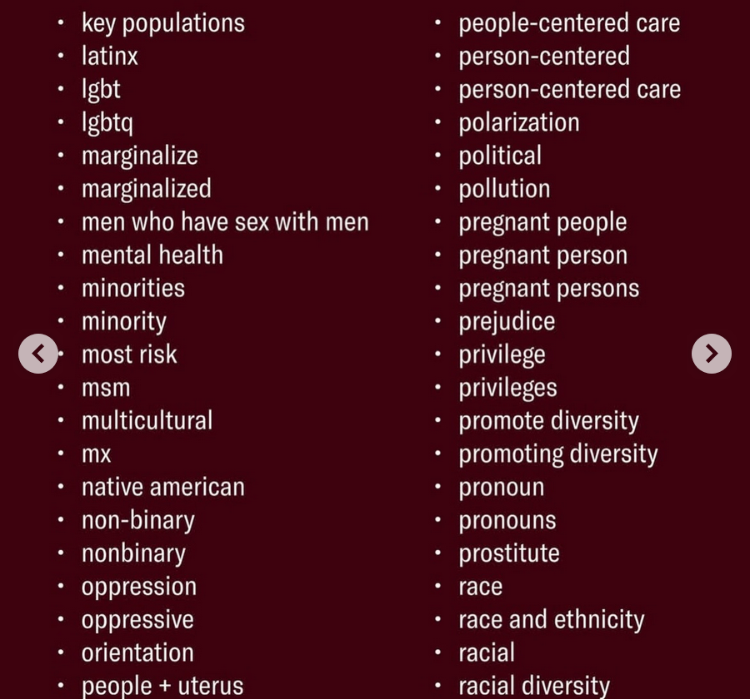
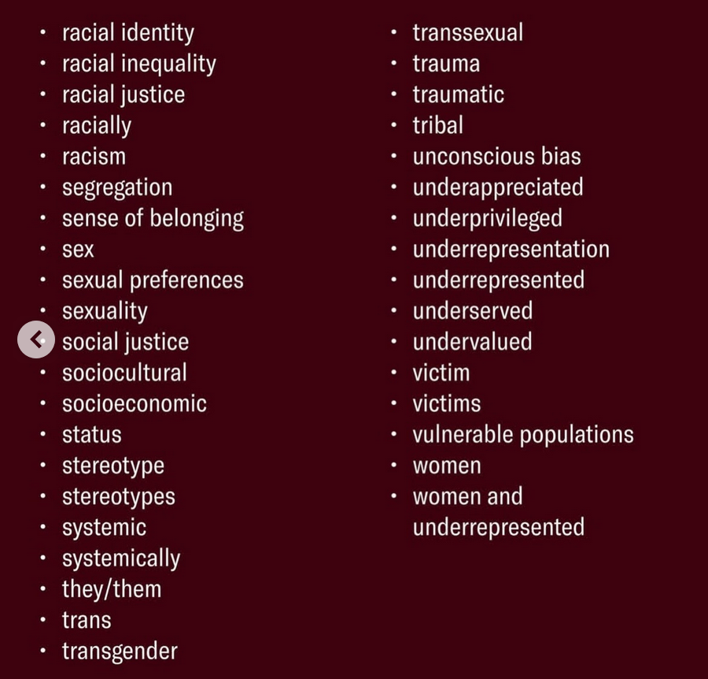
Office of Head Start Staff – Examples Continued
Notes:
Nearly 200 words prohibited when describing Head Start program
Some of the banned terms are required by Head Start and other laws: e.g. culturally appropriate, disability, disparity, diverse,
Others are total non-sequitors: commercial sex worker
Others are very broad: advocate, identity,

Slide 40
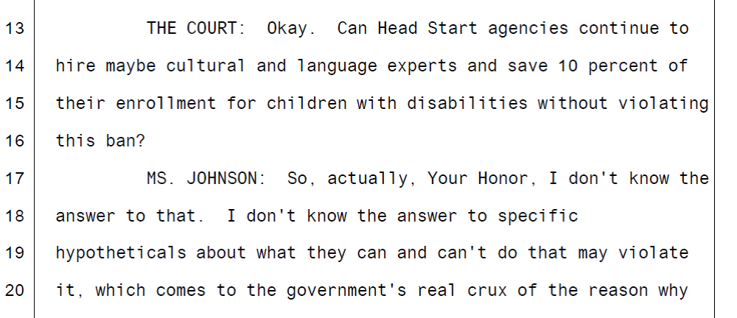
Counsel for Defendants – Example

Slide 41
Why Challenge DEIA Ban for Head Start?
Primary Reason: Head Start agencies cannot promote inclusion or accessibility, undermining their ability to comply with their obligations under the Head Start Act and Section 504, and thus undermining equal education for young children with disabilities.
Context: attacks on the social safety net programs that are essential to survival and to the ability of women to work outside the home and be financially independent.
Context: erosion of democracy through disregarding the rule of law i.e clear statutory text

Slide 42
Claims Brought to Challenge DEIA Ban
Constitutional
  Separation of Powers / Spending Clause
  First Amendment
Administrative Procedure Act
  Contrary to Law
  Arbitrary and Capricious
Section 504

Slide 43
Section 504 Claim
Section 504 text:
  “no otherwise qualified individual with a disability in the United States . . . shall, solely by reason of his or her disability, be excluded from the participation in, be denied the benefits of, or be subjected to discrimination under any . . . program or activity conducted by any Executive agency . . . .” 29 U.S.C. § 794(a).
Our argument: By making the denial of “inclusion” and “accessibility" a condition of Head Start agencies federal funding, HHS is violating Section 504.

Slide 44
Section 504 Elements
“Qualified individual with a disability”
“Executive Agency”
“Program or activity conducted by any Executive agency”
Specifically a “federal provider”
“narrow category of § 504(a) violations committed by federal funding agencies acting as such—that is, by ‘Federal provider[s].’” Lane v. Pena, 518 U.S. 187, 193 (1996) (quoting 29 U.S.C. § 794(a)(2)).
*waiver of sovereign immunity
Notes:
(1) Plaintiffs have members that have or serve children who have been diagnosed with ADHD, intellectual disabilities, and learning disabilities, among other disabilities.
These children have physical or mental impairments that substantially limit a number of major life activities, including thinking, learning, and communicating.
As such, children that plaintiffs serve are qualified individuals with a disability within the meaning of Section 504.
(2) HHS is an “Executive Agency” within the meaning of 29 U.S.C. § 794(a);
5 U.S.C. § 105 (“Executive agency” means an Executive department);
5 U.S.C. § 101 (The Executive departments are: . . . The Department of Health and Human Services.”)
(3) The administration of the Head Start program by Defendants is a federally conducted program or activity subject to Section 504 of the Rehabilitation Act.
(4) By making the denial of “inclusion” a condition of Head Start agencies federal funding, HHS, through OHS, is acting in its capacity as a “Federal provider” and sovereign immunity is waived. 29 U.S.C. § 794a.

Slide 45
Section 504 Elements – Continued
“excluded from the participation in, be denied the benefits of, or be subjected to discrimination”
Section 504 Regulations | 45 C.F.R. § 85.21
  Equal opportunity to benefit
  Most integrated setting
  Methods of administration
Notes:
Equal opportunity to benefit: Providing a qualified individual with handicaps with an aid, benefit, or service that is not as effective in affording equal opportunity to obtain the same result, to gain the same benefit, or to reach the same level of achievement as that provided to others. 45 C.F.R. § 85.21(b)(1)(iii);
Most integrated setting: Providing different or separate aid, benefits, or services to individuals with handicaps or to any class of individuals with disabilities than is provided to others, where such action is not necessary to provide qualified individuals with disabilities with aid, benefits, or services that are as effective as those provided to others. Id. § 85.21(b)(1)(iv); and
Methods of Administration:
Failing to “administer programs and activities in the most integrated setting appropriate to the needs of qualified individuals” with disabilities. Id. § 85.21(d); and
Utilizing criteria or methods of administration the purpose or effect of which would—(i) Subject qualified individuals with disabilities to discrimination on the basis of disability; [and] (ii) Defeat or substantially impair accomplishment of the objectives of a program or activity with respect to individuals with disabilities. Id. § 85.21(3)

Slide 46
Theory 1: As-Applied Discrimination
DEIA Ban forbids "initiatives” and “programs” that “promote” “inclusion” and “accessibility.”
Those initiatives and programs (e.g. program modifications and training) are necessary to provide children with disabilities early childhood programs, services, and experiences alongside their non-disabled peers.
The DEIA Ban denies disabled children access to HHS services in the most integrated setting that are not separate from those provided to non-disabled children.

Slide 47
Theory 2: Facial Discrimination
Prohibiting inclusion in early childhood education facially singlsingles out children with disabilities for discriminatory treatment = per se discrimination
Notes:
See Bay Area Addiction Rsch. & Treatment, Inc. v. City of Antioch, 179 F.3d 725 (9th Cir. 1999) (ordinance that prohibited the operation of methadone clinics within 500 feet of residential areas “facially discriminates on the basis of appellants’ disability”).

Slide 48
Current Status of Case
January 6, 2026, preliminary injunction telling HHS that it must stop implementing or enforcing the DEIA Ban.
  *Only ruled on arbitrary and capricious claims*
Fully Briefed Motion to Dismiss on All Claims Waiting for Decision

Slide 49
Discussion

Slide 50
Themes from New Hampshire and Head Start
  Disabled people are not the primary target of these anti-DEI actions
  But nor is the inclusion of disability incidental or accidental
    Neither federal government nor New Hampshire backed down when faced with the conflict between their bans and federal disability rights laws
Notes:
2:33-2:43 Yasmin
These rules will be in your materials
Model Rule for Professional Conduct – a form of which is adopted in every state
Example of a Voluntary Standard for Civility
These 2 rules interact closely with each other
Even though one is a voluntary rule and
The other is a standard for professional conduct
Let's first talk about bottom line ethical standards
We can't alter, conceal, obstruct, falsify evidence
One of the most important parts of this rule are knowing what you might be up against
What opposing counsel reputation is
The world can become very small when we start to gather data on opposing counsel
Anyone who has ever been accused of violating these rules – even if there wasn't a finding – one's reputation will follow them closely
You can usually find out if people have reputations for these violations by talking to others who have opposed them in the past
Principles may seem obvious, but you will hear lots of stories of people who didn't find them so
Back in the days of when documents were delivered, it was found to be unethical to include an exploding dye pack in those documents
Attempting to delete emails that were discoverable
Very important in the electronic age, as some have found it tempting but meta-data always uncovers ones trails
Over-redaction
And arguments that it is unintentional
I encourage you to keep a close record

Slide 51
Themes from New Hampshire and Head Start
  Disability rights laws are uniquely well situated to challenge anti-DEI efforts
  Squarely about equity (i.e. differential treatment in order to avoid equitable outcomes)
    Reasonable accommodations
    Special education
    Auxiliary aids and services
    Child Find

Slide 52
Themes from New Hampshire and Head Start
  Potential for powerful gains from disability claims,
    but also
  Risks of highlighting disability claims
  Do include disability claims mindfully, when there is a particular claim and purpose
  Don’t add disability claims as a Hail Mary
Notes:
2:33-2:43 Yasmin
These rules will be in your materials
Model Rule for Professional Conduct – a form of which is adopted in every state
Example of a Voluntary Standard for Civility
These 2 rules interact closely with each other
Even though one is a voluntary rule and
The other is a standard for professional conduct
Let's first talk about bottom line ethical standards
We can't alter, conceal, obstruct, falsify evidence
One of the most important parts of this rule are knowing what you might be up against
What opposing counsel reputation is
The world can become very small when we start to gather data on opposing counsel
Anyone who has ever been accused of violating these rules – even if there wasn't a finding – one's reputation will follow them closely
You can usually find out if people have reputations for these violations by talking to others who have opposed them in the past
Principles may seem obvious, but you will hear lots of stories of people who didn't find them so
Back in the days of when documents were delivered, it was found to be unethical to include an exploding dye pack in those documents
Attempting to delete emails that were discoverable
Very important in the electronic age, as some have found it tempting but meta-data always uncovers ones trails
Over-redaction
And arguments that it is unintentional
I encourage you to keep a close record

Slide 53
Themes from New Hampshire and Head Start
  Importance of intersectional collaboration
  Using the power of disability in support of a broad range of impacted communities
Notes:
2:33-2:43 Yasmin
These rules will be in your materials
Model Rule for Professional Conduct – a form of which is adopted in every state
Example of a Voluntary Standard for Civility
These 2 rules interact closely with each other
Even though one is a voluntary rule and
The other is a standard for professional conduct
Let's first talk about bottom line ethical standards
We can't alter, conceal, obstruct, falsify evidence
One of the most important parts of this rule are knowing what you might be up against
What opposing counsel reputation is
The world can become very small when we start to gather data on opposing counsel
Anyone who has ever been accused of violating these rules – even if there wasn't a finding – one's reputation will follow them closely
You can usually find out if people have reputations for these violations by talking to others who have opposed them in the past
Principles may seem obvious, but you will hear lots of stories of people who didn't find them so
Back in the days of when documents were delivered, it was found to be unethical to include an exploding dye pack in those documents
Attempting to delete emails that were discoverable
Very important in the electronic age, as some have found it tempting but meta-data always uncovers ones trails
Over-redaction
And arguments that it is unintentional
I encourage you to keep a close record

Slide 54
Questions and Answers
Notes:
3:40-3:45

Slide 55

For more information:
Zoe Brennan-Krohn, zkrohn@aclu.org
Jennesa Calvo-Friedman, jcalvo-friedman@aclu.org
Alexis Alvarez, alexisa@aclu.org
Photo Copyright Flickr-Via Tsuji

Slide 56
WE THE PEOPLE

