Slide 1
Litigating ADA Cases Involving Police Misconduct and Mental Health Crises:
Recent developments in the case law
Neel Lalchandani
Attorney
Brown Goldstein & Levy
02
Elizabeth Cruikshank
Senior Counsel
Institute for Constitutional Advocacy Protection
03
Malhar Shah
Attorney
ACLU Disability Rights Program
04
Jamie Strawbridge
Attorney
Brown Goldstein & Levy
01

Slide 2
Three Cases:
LeRoux v. Montgomery County
C.B. v. Moreno Valley Unified School District
Rohrer v. City of Gastonia

Slide 3
LeRoux v. Montgomery County
Plaintiff: Estate of Ryan LeRoux, a Black man who had mental health disabilities
Jurisdiction: District of Maryland
Core allegations:
  County police department dispatched an armed officer to respond to call for assistance for Mr. LeRoux, despite confirming he was not acting in threatening or dangerous manner
  Despite knowing that Mr. LeRoux had mental health disabilities that prevented him from complying with orders, officers failed to provide reasonable accommodations and instead escalated the situation then shot and killed him
Legal claim: Title II of the ADA, Section 504, Negligence, Wrongful Death
Notes:
MALHAR (4 Minutes)
Shackling https://www.aclu.org/cases/sr-v-kenton-county-sheriffs-office
Police referrals and arrests https://dredf.org/c-b-v-mvusd-et-al/

Slide 4
C.B. v. Moreno Valley Unified School District
Plaintiff: Black, disabled boy with “emotional disturbance”
Jurisdiction: Central District of California
Core allegations:
  District called security/school police on plaintiff four times for disability-related barriers;
  They restrained, handcuffed, and arrested him each time
Legal claim: Title II of the ADA, Section 504
Notes:
MALHAR (4 Minutes)
Shackling https://www.aclu.org/cases/sr-v-kenton-county-sheriffs-office
Police referrals and arrests https://dredf.org/c-b-v-mvusd-et-al/

Slide 5
Systemic Facts Learned in Discovery
District disproportionately referred and restrained disabled students:
  Referred disabled students to police 8.97 times more than others;
  Referred Black disabled students to police 6.28 times more than others;
  Police restrained disabled students 2.6 times more than others;
  Police restrained Black disabled students 3.81 times more than others.

Slide 6
Unfettered Discretion to Refer and Restrain
Staff could refer students to police when:
  They “feel they need support”
  Behavior “disrupting the educational process for students”
  No exceptions for disability-related behaviors
Police could restrain students when:
  student attempts to escape or attempts to destroy property
  for any act of physical aggression.
  No exception for disability-related behaviors.

Slide 7
No Policies or Training for De-escalation:
Lack of policies, procedures, or training:
  No policies or procedures requiring law enforcement to provide accommodations to disabled students
  Training did not teach police how to accommodate disabled students;
  Existing training did not contemplate students with complex behavioral needs, including autistic students

Slide 8
Summary Judgment Decision
Methods of Administration:
  Unfettered discretion to refer disabled students to police;
  Police can restrain disabled students for disability-related behaviors;
  No exceptions for disability-related behaviors;
  Training does not equip police to avoid use of restraints.
Discriminated against disabled students:
  Denial of equal opportunity to benefit or participate;
  Disabled students disproportionately referred to police;
  Disabled students disproportionately removed from class;
  Disabled students disproportionately restrained when could be de-escalated.
Notes:
ASHIKA
Slides 28-38 (15 mins)
Bread for the City v. District of Columbia https://www.aclu.org/cases/bread-for-the-city-v-district-of-columbia
Disability Rights Oregon v. Washington County, Oregon https://www.aclu.org/cases/disability-rights-oregon-v-washington-county-oregon

Slide 9
Permanent Injunction
5-year independent monitor
Must create/modify policies, procedures, and trainings to:
  Reduce referrals of disabled students to police
  Reduce removal of disabled students from class
  Reduce restraints of disabled students
Limit staff’s discretion to refer disabled students to police;
Create data system for tracking these points and correcting
disproportionality

Slide 10
Ongoing Litigation: Rohrer v. City of Gastonia
Plaintiff: Homeless veteran with PTSD and other disabilities.
Jurisdiction: Western District of North Carolina.
Core allegations:
  Plaintiff was standing and waving on a median with his service dog, Sunshine.
  Plaintiff had told officer days earlier that he had a 100 percent disability rating from the VA for PTSD and needed a service animal “to function.”
  Officers forcefully arrested Plaintiff and tased Sunshine, who ran off.
  City used PD Facebook page to bully, harass, and defame the Plaintiff.
Legal claims: First Amendment, Fourth Amendment, Title II of the ADA, Section 504, state tort claims.
Notes:
ELIZABETH
Shackling https://www.aclu.org/cases/sr-v-kenton-county-sheriffs-office
Police referrals and arrests https://dredf.org/c-b-v-mvusd-et-al/

Slide 11
The Context
Homelessness in Gastonia:
  Homelessness crisis in Gastonia; no full-time shelters.
  Police mandate to “find a solution that would deter the homeless from congregating in open areas that are visible” to passing motorists and the downtown business area.
  Anti-solicitation law prohibits panhandling on medians.
Plaintiff and the Police:
  Four days before arrest, Plaintiff told Officer Taylor he had a 100 percent disability rating for PTSD and needed a service animal to “function.”
  Before the arrest, Plaintiff told Officer Brooks he was a “disabled veteran who’s living in the woods.”
  Sunshine wore a vest prominently identifying her as a service animal.
  Officer Brooks threatened to separate Plaintiff from Sunshine and call Animal Control on him if he did not comply with her orders.

Slide 12
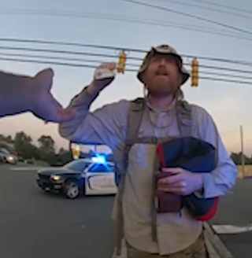
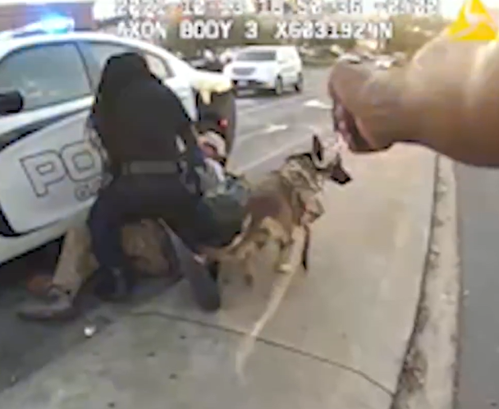
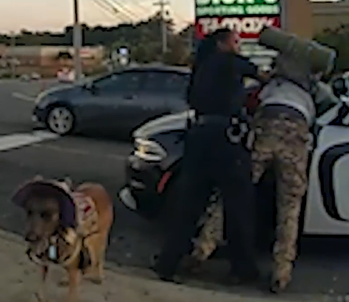
The Arrest
Taylor: “Call your dog off.”
Brooks: “I don’t think he’s [sic] going to bite.”
Taylor: “He just bit me.”
Taylor: “I need your state ID, not your VA ID.”
Plaintiff: “It’s not even valid. It’s out of date.”
Taylor: “All right, turn around. You’re being arrested.”
Moment of the tasing

Slide 13
The Aftermath
Sunshine ran off and was picked up by a stranger; police made no effort to retrieve or contain her.
Days later, she was hit by a car and killed while Plaintiff and others in the community searched for her.
A public campaign began to support Plaintiff and the homeless community in Gastonia and to urge for the release of the bodycam footage.
In response, Gastonia Police Department posted hundreds of disparaging, bullying, harassing, and false comments about Plaintiff on its official Facebook page.

Slide 14
The Complaint
First Amendment: Anti-panhandling law facially unconstitutional.
Fourth Amendment:
  Excessive force (against Plaintiff).
  Unreasonable seizure (against Sunshine).
Title II and Rehab Act:
  Failure to accommodate.
  Disability discrimination.
First Amendment retaliation and state law tort claims for defamation and IIED.

Slide 15
Significant Disability Rights Issues
Failure to accommodate and exigent circumstances.
Proving municipal liability for Title II and Rehab Act violations.
Damages for Title II and Rehab Act claims post-Cummings.

