Slide 1
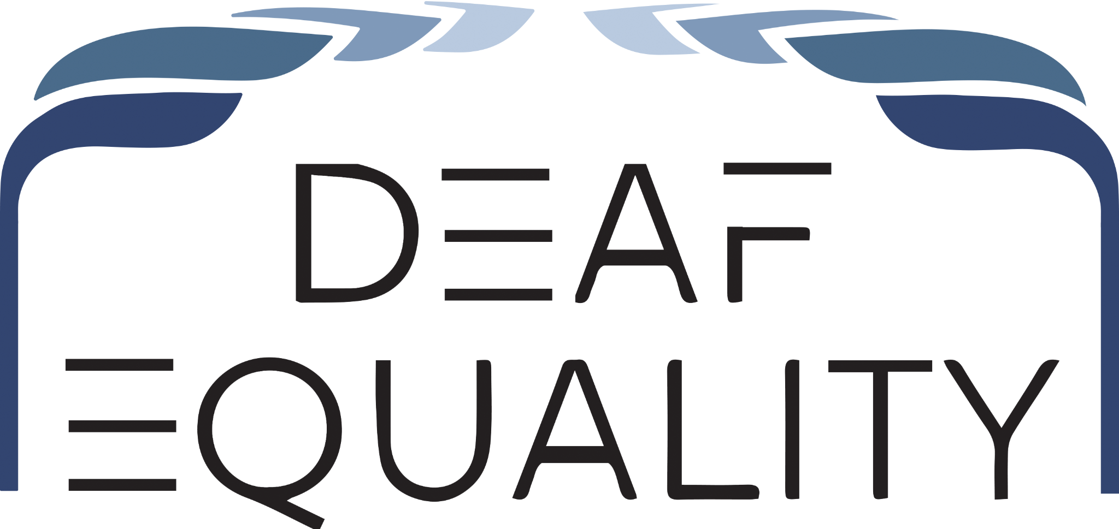
Creative Strategies for
Communication Access System Change
Howard Rosenblum, Esq.
Zainab Alkebsi, Esq.
Anna Bitencourt, Esq.

Slide 2

About Deaf Equality
Notes:
Include Deaf/HOH short form explainer

Slide 3
Persistence of Communication Barriers
Despite decades of 504 and ADA, communication access issues persist
Litigation provides short term relief
Denial of communication access is still a huge problem
Need to go beyond traditional models, system change needed

Slide 4
Working Together on Changing the System
We will share several ideas for “outside-the-box” strategies for advancing communication access - system-level solutions
But meaningful change requires partners within the legal profession
Your collective participation can help implement and scale these ideas in your own areas
Notes:
Z

Slide 5
Concept Example: iTRS Fund
Telecommunications companies contribute to a centralized fund that supports access to relay services rather than placing the economic burden on individual users
Shared responsibility across industry is a model for other accessibility gaps - pooled funding tied to participation in a system
Model for how accessibility works best when it is built into the system, not case by case
Notes:
Z

Slide 6
  Medical Settings
    Refusal or delay in providing qualified interpreters
    Over-reliance on VRI in inappropriate situations
    Using family/friends as interpreters
  Legal Settings
    Refusing to accept Deaf/HOH clients
    Passing access expenses onto the client
    Inadequate communication with Deaf/HOH client
Worst Offenders: Doctors and Lawyers

Slide 7
Communication Access Fund (CAF)
Licensed professionals pay dues that partially go to funds such as for addiction services
Add a Communication Access Fund
Modest increase to dues can cover a CAF
CAF would cover costs of communication access for all interactions between consumers and professionals
Removes economic disincentive
Facilitates appropriate access

Slide 8
Refusal or delay in providing qualified interpreters
Limiting access to meetings, trainings, or advancement opportunities
Inconsistent provision of accommodations
Budget-based denials or misuse of access funds
Failure to engage in interactive process
Retaliation, write-ups or negative performance reviews due to issues with accommodations
Common Employment Barriers

Slide 9
Centralized Employment Reasonable Accommodations Fund
In many workplaces, accommodation costs come out of department budgets = economic disincentive to hire employees with access needs
Managers often lack expertise on how to arrange accommodations
Solution: establish company-wide fund for workplace accommodations
Leads to hiring based on talent rather than worrying about costs
Centralized specialist with expertise can coordinate services
Turns access into organizational infrastructure
Notes:
Z

Slide 10
Refusal or delay in providing qualified interpreters
Over-reliance on VRI
Untrained staff and inconsistent access policies
Poor documentation of accommodation requests
Impact
Delayed or inadequate care
Misunderstood diagnoses and lack of informed consent
Unsafe discharge, trauma, and loss of trust
Common Hospital Barriers

Slide 11
Addressing Hospital Failures
Hospitals are the absolute worst for communication access, decades of litigation has not made a dent
Need different approach to compel access
What is a stronger incentive? Accreditation
Joint Commission
State Departments of Health

Slide 12
Collaborative Strategies
Takes all of us to achieve system change
Litigation has achieved some system change, but communication access issues need more
CAFs and State Health accreditation require state by state collaborative efforts
Other ideas for system change are needed
Notes:
ALL

Slide 13
Q & A

