Slide 1

Accessible Voting
New Gains and Challenges for the 2026 Midterms
Evan Monod, Staff Attorney, The Arc
Lauren Kelleher, Partner, Brown, Goldstein & Levy
Marisa Leib-Neri, Disability Rights Fellow, Brown, Goldstein & Levy

Slide 2

Introductions
The Arc is the largest member organization for individuals with intellectual and developmental disabilities and their families. The Arc of the United States is the national office. The Legal Advocacy team often represents over 600 state and local chapters in litigation
Brown, Goldstein & Levy (BGL) is a client-centered law firm that brings decades of experience and passionate, effective advocacy to the fight for justice. Attorneys at BGL practice around the country and have a wide depth of experience in disability rights and voting rights lawsuits.

Slide 3
Presentation Overview
Part 1: Challenges to In-Person Voting
Part 2: Challenges to Absentee Voting
Part 3: Challenges to Injunctive Relief & Class Actions
Questions?

Slide 4
Part 1:
Challenges to In-Person Voting

Slide 5
La Union del Pueblo Entero v. Abbott (LUPE)
The Arc National Office represents The Arc of Texas in LUPE
Lawsuit was filed back in 2021 on the heels of Texas Senate Bill 1. Three separate cases were consolidated into one, with more than fifteen organizational plaintiffs representing a broad coalition of racial, ethnic, voting rights, and disability organizations, including The Arc of Texas.
There have been seven interlocutory and merits appeals in this case. We will only be talking about two of them today.

Slide 6
Overview of SB 1 Assistor Provisions
Pre SB 1: Texas allowed people with physical disabilities or those with limited English proficiency to receive assistance at a polling place. Assistors had to swear a basic oath and disclosure form in order to serve.
Post SB 1:
  Assistors swear a new oath under penalty of perjury, which is punishable by a fine and up to two years in prison. No time limit on threat of criminal penalty.
  Assistors also must fill out new disclosure forms. These disclosures include the penalty of perjury, which again carries a two-year prison sentence and a fine. More information must be disclosed.
  Poll workers who serve as assistors are subject to none of these requirements.

Slide 7
Overview of Mail-in Ballot Provisions
  Pre SB 1: Only allowed mail-in ballots for voters over age 65, disabled voters who cannot vote in person without assistance or injury to their health. Limited numbers of non-disabled voters can vote by mail. Voters must apply to vote by mail.
  Post SB 1:
    New identification requirement matching requirement at the application and voting stages.
    New disclosure forms that carry penalty of perjury.
    Ban on compensated assistance for mail-in balloting.

Slide 8
How do these Provisions Affect PwDs?
  Voters with disabilities are four times more likely to vote by mail than voters without disabilities.
  SB 1’s mail ballot ID requirements led to skyrocketing rates of rejection. Online ballot cure process is inaccessible to many voters with disabilities.
  Texas election officials admitted that disabled voters are far more likely to vote by mail in Texas. Many older and disabled voters cannot remember or access the ID number associated with their voter registration record.
  Numerous election officials admitted that they have an affirmative obligation to accommodate voters with disabilities who require assistance when voting but also admitted that they have no idea how to actually accommodate voters with disabilities after SB 1.
  Many blind and low-vision voters reported being unable to see the ID requirement on the mail-ballot form.
  One-fifth of voters with disabilities receive voting assistance from non-family members. This includes more than 1,000,000 voting-eligible Texans with intellectual disabilities.

Slide 9
SB 1’s Effects on Arc Members
  Nancy Crowder has a progressive neuromuscular condition and needs an attendant to help her complete various activities of daily living. She usually votes with her attendant as her assistor. She elected not to after SB 1, for fear of criminal liability.
  Terri Saltzman is a blind member of The Arc whose mail in ballot was rejected under the ID rule due to her inability to see the ID requirement (which was placed under the ballot envelope flap). She could not cure her ballot due to the inaccessibility of the curing website. When she appealed to Travis County for help, they offered no assistance or modification of SB 1’s requirements.
  Lydia Nunez Landry is a member of The Arc with muscular dystrophy who votes with assistance. Again, she was wary of potential criminal penalty on her assistor. She has chosen to vote without assistance. Poll workers refused to help her. Instead, they simply watched her struggle to select her preferred candidate. It “made me really nervous. . . they all voted with me.”

Slide 10
Section 208 Claims/Appeal
  Section 208 language: Any voter who requires assistance to vote by reason of blindness, disability, or inability to read or write may be given assistance by a person of the voter’s choice, other than the voter’s employer or agent of that employer or officer or agent of the voter’s union.
  Trial Court Decision: SB 1 is preempted by Section 208. Texas cannot impose additional limitations on assistance that are not stated in Section 208.
  Fifth Circuit Decision: None of the plaintiffs have standing to challenge the oath provisions, because the fear of criminal liability is too speculative. Plaintiffs have standing to challenge the compensation of assistor provisions, but those are not preempted by Section 208 because it only guarantees that an assistor is available, not an assistor of a person’s choice. Judge Graves dissents.

Slide 11
ADA Claims Decision
Plaintiffs have standing to challenge the assistor provisions (same as 208).
Plaintiffs are denied meaningful access to Texas’ voting program. Texas’ “no harm no foul” approach is inconsistent with the ADA.
A disabled plaintiff who encountered more difficulty in casting a ballot but was ultimately successful is still denied reasonable access to voting.
Texas has affirmative obligation to accommodate voters with disabilities.
Proposed injunctive relief is a return to pre-SB 1, no fundamental alteration.

Slide 12
Judge Rodriguez on SB 1:
“This perfect storm has forced many voters with disabilities to confront S.B. 1’s novel burdens alone. In attempting to exercise their most sacred right. . . disabled voters have had their. . .mail ballots rejected repeatedly and been forced to spend additional time and effort navigating burdensome workarounds to ensure that their votes are counted. Even voters who were able to successfully cast a ballot often endured the loss of their privacy, embarrassment, fear, and even physical pain. Under these conditions, it is likely that many disabled voters will be dissuaded from attempting to vote in the first place. Texas voters with disabilities deserve better, and the ADA and Section 504 demand more.”

Slide 13
Pending Fifth Circuit Appeal
Plaintiffs have standing (Section 208 decision does not control).
Plaintiffs were denied meaningful access and reasonable accommodations, with a focus on Texas’ affirmative obligations.
Defendants’ belated disparate impact argument is untimely and inapposite.
District Court’s remedy is proper, no fundamental alteration.
Argument is set for the last week of April.

Slide 14
Part 2:
Challenges to Absentee Voting

Slide 15
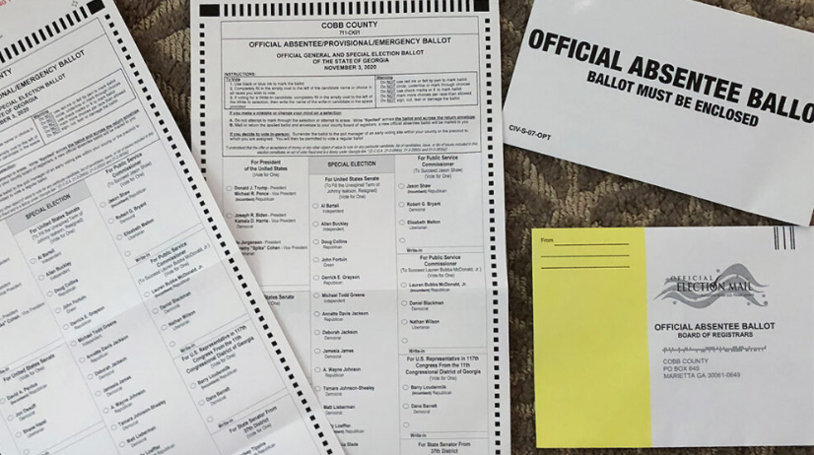
Absentee Voting
Why it Matters
Convenient/flexible timing
No travel burdens
Allows individuals with other health
or mobility issues to remain at home
Research after you receive your ballot
Why it is an issue
One word: paper
​
The Solution: Remote Accessible Vote-by-Mail Systems (RAVBMs)
Electronic delivery AND return
​

Slide 16
Challenges to Inaccessible Absentee Voting Programs
Title II, Americans with Disabilities Act
Section 504, Rehabilitation Act
The regulations are our friend!
Discrimination on the basis of disability through:
  Lack of effective communication
  Failure to provide auxiliary aids and services
  Failure to provide an equal opportunity to vote privately and independently
Title II and its regulations are based on Section 504 and claims are often evaluated together.
Prohibits:
  Excluding individuals with disabilities from OR
  Preventing them from participating in OR
  Denying them benefits or services of OR
  Subjecting them to discrimination under
  Any program or activity receiving federal financial assistance
    Ex. HAVA

Slide 17
NFB v. Lamone
The one that started it all!
Beginning in 2012, Maryland developed an online ballot marking tool and consulted with the NFB on how to make it more accessible.
In 2013, citing security concerns, the state legislature passed a law requiring that the tool be certified by the Board of Elections. The BOE failed to provide that certification and voters with print disabilities lost the option of voting absentee privately and independently.
The NFB, along with several Maryland NFB members, sued the BOE and the case ultimately settled after an important victory at the Fourth Circuit, which established some of the foundational law that we have relied on since in litigating similar cases across the country.

Slide 18
NFB v. Lamone (con.)
Important Precedent
The "program" at issue is absentee voting not voting generally.
Denying individuals with disabilities the same private and independent voting experience as those without disabilities—and thus forcing them to rely on others to vote absentee—is discrimination on the basis of disability.
A preexisting tool without no known security issues—that had been "used in actual elections without apparent incident"—was a "reasonable modification" to the program that did not create an undue burden or fundamentally alter the absentee voting program.

Slide 19
Johnson v. Bexar County
Acquiring a new RAVBM system
The NFB of Texas, and several NFBTX members, initially sued the Texas SOS but voluntarily dismissed after the SOS argued the counties, not the SOS, administered the absentee voting program.
Sued Bexar County instead, which has a county elections manager who was open to creating accessible absentee voting options.
The parties agreed regarding the accessibility issues; the remaining issue was the County's argument that the Texas Elections Code prevented it from distributing non-paper absentee ballots.
Won at summary judgment under Title II of the ADA, which the court found preempted any state law. Got a permanent injunction ordering the implementation of a RAVBM system in Bexar County.
Time for other Texas counties to follow suit!

Slide 20
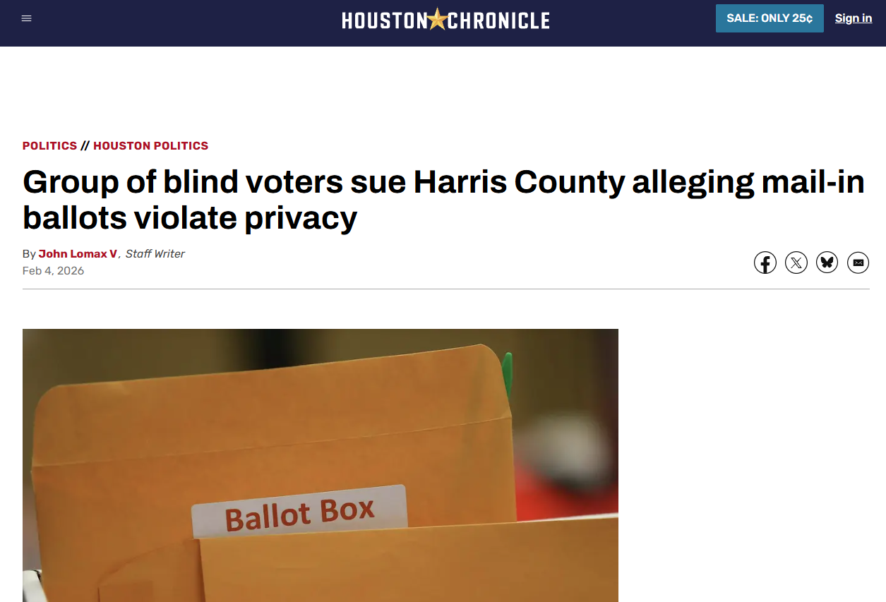
NFBTX v. Harris County
Our newest lawsuit, again on behalf of NFBTX, one of its members and other Texas voters with print disabilities against Harris County and the county clerk.
Co-counseling again with Disability Rights Texas.
Seeking same relief under the same theory as the Johnson v. Bexar County case.
Complaint filed on February 3, 2026. Waiting on formal response but hopeful that we can work collaboratively with the county.

Slide 21
Rissling v. Bobo
Alabama and E-Return
Another case initially brought against the SOS. Was dismissed by the Court and refiled against the three most Alabama Counties: Jefferson, Mobile, and Tuscaloosa.
In previous cases, asked for electronic delivery to voters; here, asking for electronic return as well.
Accessible system that includes e-return already in use for Alabama military and overseas voters.
The counties have argued that in person early voting accessible devices suffices under the ADA and that offering electronic return to voters with print disabilities would pose security risks.

Slide 22
CA Council of the Blind v. Weber
E-Return, Again
California already has RAVBM voting available in any county to any registered voter, thanks to prior litigation.
In 2024 NFBCA along with CCB and several individual plaintiffs—and represented by Disability Rights California, Disability Rights Advocates, and BGL—sued the California SOS, challenging its failure to provide accessible, electronic return for individuals under federal (ADA, Rehabilitation Act) and state anti-discrimination laws.
Paper return presents many of the same challenges as voting a paper absentee ballot.
Proceeding on behalf of a class of all registered voters with print disabilities across the state.

Slide 23

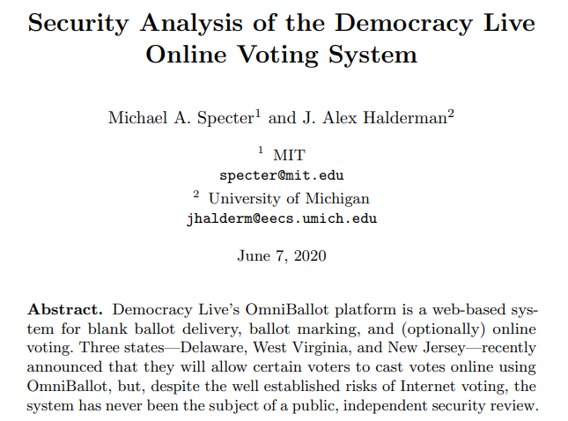
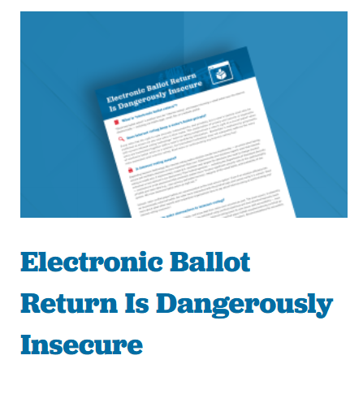
Organizational and Academic Opposition to E-Return
Stated Concerns
"Internet voting"
Secure and verifiable elections and public confidence in results.
Paper trail
Advocacy
Academic papers
Expert witnesses
Amicus briefs

Slide 24
Part 3:
Challenges to Injunctive Relief
& Class Actions

Slide 25
Trump v. CASA
What about statewide injunctive relief?
2025 Supreme Court case that held that use of “universal injunctions” exceed the equitable authority granted to the federal courts by the Judiciary Act of 1789.
A universal injunction as any injunction that “prohibit[s] enforcement of a law or policy against anyone.”
While universal injunctions are unacceptable, injunctions that prohibit enforcement of law or policy as to specific plaintiffs with standing and that fashion relief narrowly to those parties, are allowed.

Slide 26
Trump v. CASA (con.)
Statewide injunctions are also not safe under CASA’s ban on the universal injunction. Though different lower courts have interpreted CASA differently.
Some lower courts have interpreted CASA to prohibit any injunction of the type that attempt to “enjoin anyone,” even if that “anyone” is bound by state lines and therefore is not national in scope. See Nat'l Educ. Ass'n-New Hampshire v. NH Att'y Gen. (D.N.H. Oct. 2, 2025).
Other lower courts have decided that statewide injunction by virtue of its limits to a particular state cannot be universal. See Welty v. Dunaway (M.D. Tenn. July 18, 2025).
Other courts will grant a narrower injunction than one requested, only providing complete relief to the directly injured plaintiffs, but will not issue universal relief. See Farmworker Ass'n of Fla., Inc. v. Uthmeier (S.D. Fla. Mar. 11, 2025).

Slide 27
Post Trump v. CASA Outlook
Class Certification
A universal injunction prohibited by CASA may be able to proceed via class action. In asking for an injunction as it applied to a particular class of Plaintiffs, injunctive relief may be available statewide, regionwide, or nationwide.
A class action lawsuit sufficiently tailors the injunctive relief so as to not apply to just “anyone.”
Lower Courts applying CASA have interpreted this to means that a class does not need to be certified before an injunction is granted. A common injury is sufficient. See Am. Council of Learned Societies v. McDonald (S.D.N.Y. July 25, 2025); Barbara v. Trump (D.N.H. July 10, 2025).

Slide 28
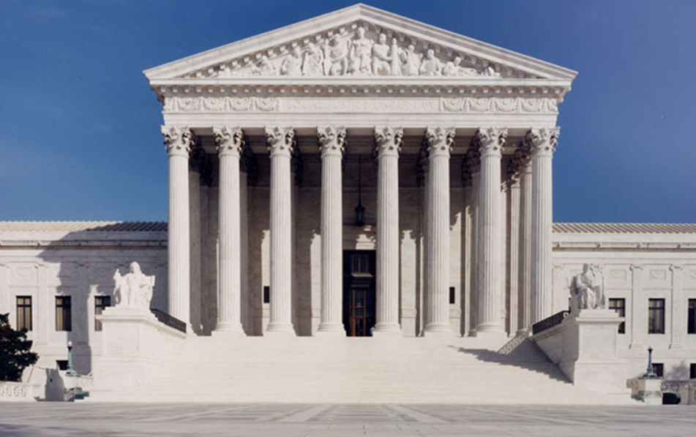
Watson v. Republican National Committee
Absentee/Mail-In Voting Faces Other Challenges
In 2020, Mississippi became the nineteenth state to accept mail-in ballots postmarked by Election Day.
In January 2024, the Republican National Committee and the Mississippi Republican Party sued the Mississippi SOS and local election officials challenging this law as impermissibly “holding voting open beyond the federal Election Day."
Plaintiffs lost at the district court and appealed to and won at the Fifth Circuit. Mississippi appealed to the Supreme Court, which heard argument this week.
A decision in favor of the plaintiffs would curtail absentee voting across the country and disproportionately harm voters, including voters with disabilities, who rely on absentee voting.

Slide 29
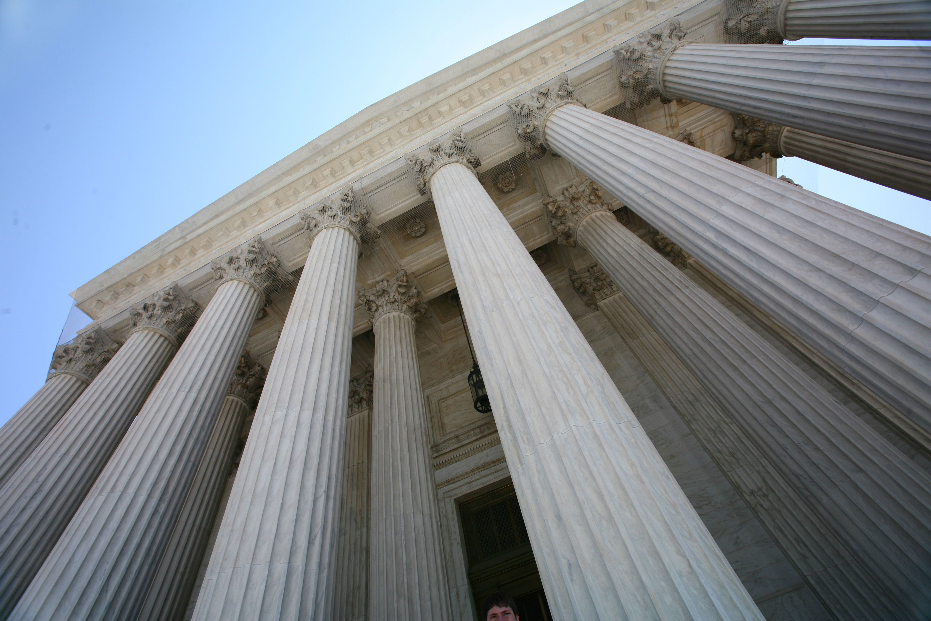
Bost v. Illinois
Other Potential Challenges to Mail-In Voting
Supreme Court decision creating new form of standing for candidates who want to challenge voting laws in their state.
Categorical rule upholding candidate standing based on a candidate’s inherent interest in the integrity of elections. No monetary or other injury needed.
Will allow candidates to challenge mail-in voting laws more easily. Ballot counting laws will be targeted most frequently
Could create new avenues to expand voting laws even if not the intention of the Supreme Court.

Slide 30
Questions?

Slide 31
Thank you!
Presenter Contact Information:
Evan Monod: monod@thearc.org
Lauren Kelleher: lkelleher@browngold.com
Marisa Leib-Neri: mleibneri@browngold.com

